Slide 1
Service-oriented Software Engineering (SoSE)
Describing REST WS with Open API and Swagger
Alfredo Farò - 303211
University of L’Aquila
alfredo.faro@student.univaq.it
(MIDTERM EXAM MAY 2025)

Slide 2
What have we done? (from previous lectures)
When a service exposes a complex interface and is not just a simple resource (e.g., involving many parameters, nested objects, or custom logic), it becomes hard to model using RESTful principles alone.
Unlike SOAP-based services, which benefit from WSDL (Web Services Description Language) to formally describe all operations and message types, REST lacks a native standard for interface description.
As a result, REST APIs are often documented:
Informally (e.g., README files, Confluence pages)
Inconsistently (different teams use different formats)
With no machine-readable format to generate clients or test tools
This creates confusion and raises the barrier for reusing or integrating with the API.
WADL
OpenAPI
WADL was an early XML-based attempt to describe REST interfaces.
✅ Pros:
Tried to bring structure to REST descriptions
❌ Cons:
XML-heavy and verbose
Poorly adopted
Lacked community and tooling support
The OpenAPI Specification allows you to:
formal documentation of REST endpoints (in YAML or JSON)
interactive exploration and testing through Swagger UI
automatic client/server code generation
easy integration into CI/CD pipeline
REST by itself doesn’t provide a way to formally describe APIs.OpenAPI fills that gap, giving REST the structure and tooling it was missing.es

Slide 3
What is Swagger?
What is Swagger (and OpenAPI)?
Swagger is a set of tools used to design, document, and test RESTful APIs, based on the OpenAPI Specification.
OpenAPI is the official standard to describe REST APIs using JSON or YAML.
Swagger provides tools to work with OpenAPI, including:
Swagger Editor: write your API definition
Swagger UI: test your API in the browser
Swagger Codegen: generate clients/servers automatically
Swagger History
Swagger started as a specification and tooling suite.
In 2015, the OpenAPI Specification (OAS) was donated to the Linux Foundation.
Today, OpenAPI is the name of the standard, and Swagger is the name of the tools built around it.
With Swagger, you can:
Document your REST API in a clear and structured way
Test endpoints via an interactive web interface (Swagger UI)
Generate client/server code and test suites (e.g., JUnit)
2017 – OpenAPI 3.0
First version under the name OpenAPI Specification (OAS).
YAML fully supported.
Introduction of reusable components (schemas, parameters, responses, etc.).Improved support for media types, headers, authentication.
2014 – Swagger 2.0
- Specification written in JSON.
- Official tools launched: Swagger Editor, Swagger UI, Swagger Codegen.
2010 – Swagger is born
Created by Tony Tam (Wordnik) to write API REST
Swagger Specification is born (v1.0 → 1.2 → 2.0)
2015 – OpenAPI Initiative is born
Swagger Specification donated to the Linux Foundation.
The OpenAPI Initiative (OAI) was formedGoal: create an open, vendor-neutral standard for describing REST APIs.
2021 – OpenAPI 3.1
Fully compatible with JSON Schema 2020-12.
Improved validation and tooling support.

Slide 4
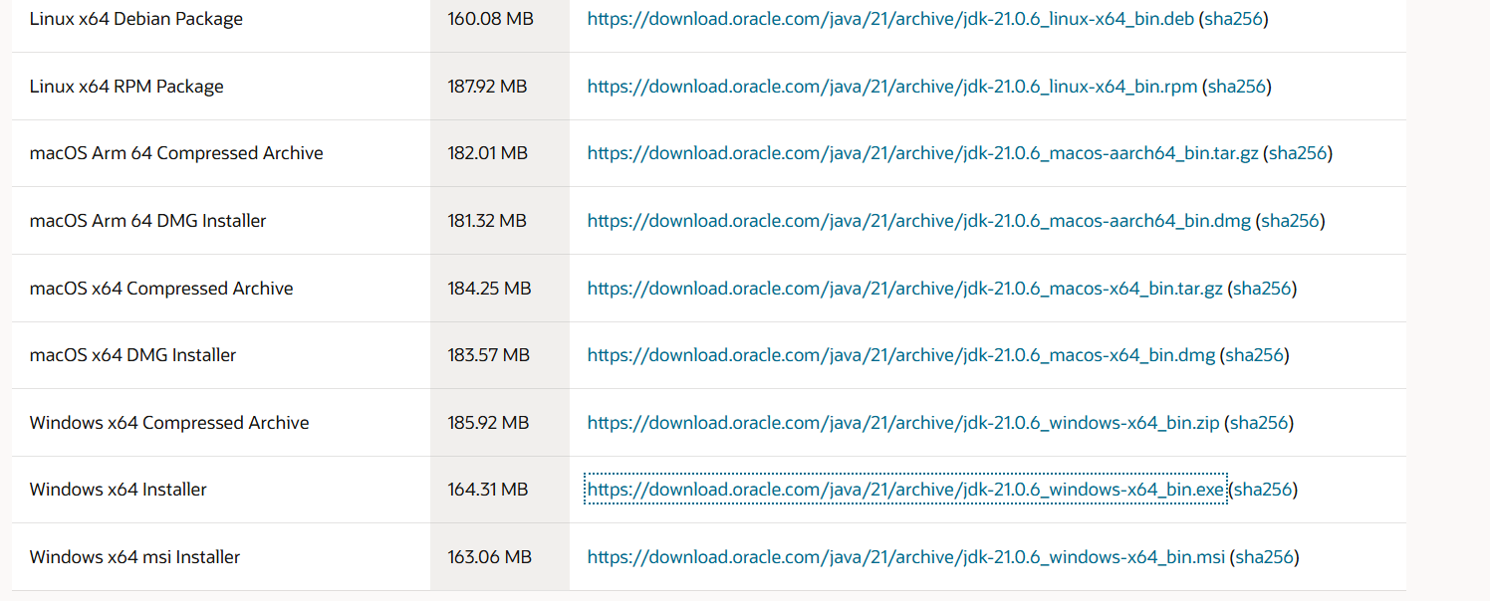
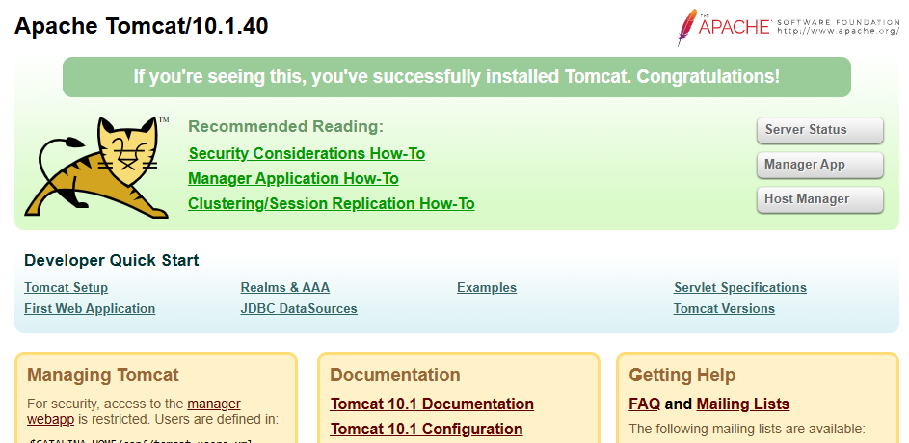
Ingredients – with the lastest versions available as May 2025
Java SE Development Kit:
✅ Latest version: JDK 21 (LTS) 🔗 https://www.oracle.com/java/technologies/javase/jdk21-archive-downloads.html ⚠️ JDK 8 is still supported in legacy systems but consider using JDK 17 or 21 for modern development.
Eclipse IDE for Enterprise Java Developers ✅ Latest: Eclipse IDE 2024-03 🔗 https://www.eclipse.org/downloads/packages
Apache Tomcat
✅ Latest stable: 10.1.40 (as of May 2025)
🔗 https://tomcat.apache.org/download-10.cgi
⚠️ Version 9 is still maintained but 10.x is recommended.
Apache CXF
✅ Latest stable: 4.0.3
🔗 https://cxf.apache.org/download.html
⚠️ Version 3.5.x still works, but version 4 adds better OpenAPI 3.1 support and Jakarta EE 10 compatibility.
Apache Maven
✅ Latest: 3.9.6
🔗 https://maven.apache.org/download.cgi
Swagger Editor
✅ Latest stable: 4.0.3
🔗 https://cxf.apache.org/download.html

Slide 5
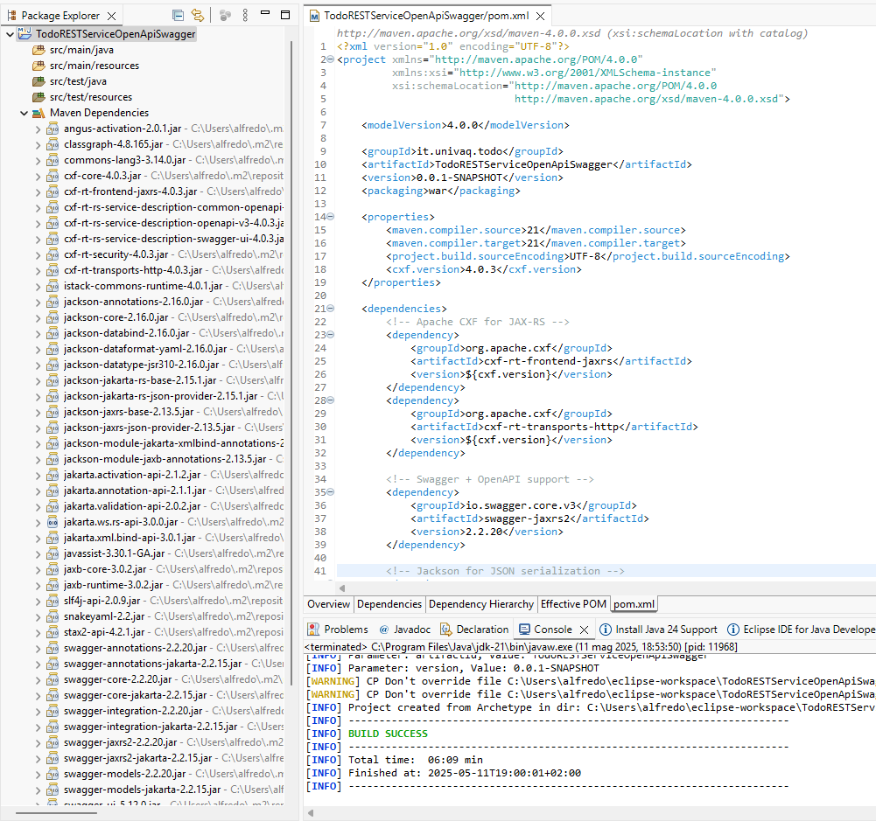
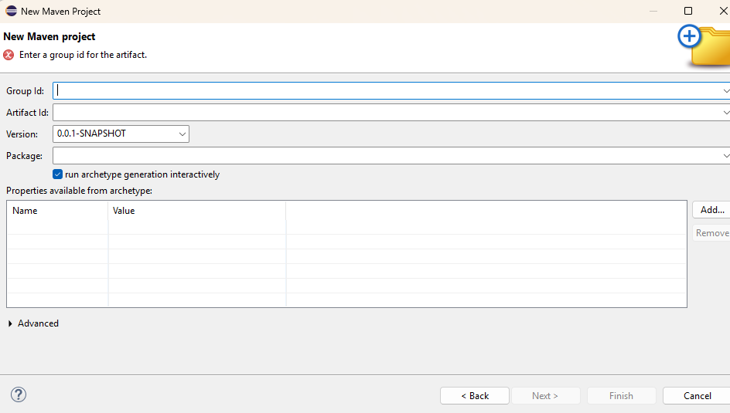
Create TodoRESTServiceOpenApiSwagger
We install Eclipse and configure Java and Maven to the previously defined versions to the system
0
1
Let's create a new maven project and configure the new jdk and the maven version we have installed
2
Define archtype, groupid and let’s create “java”, a folder for our file (also that one for the tests)
3
Define archtype, groupid and let’s define java folder for our file (also that one for the tests)
4
Update the pom.xml with the dependencies and let’s update maven

Slide 6
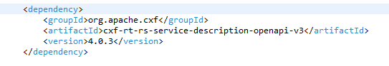
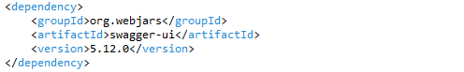
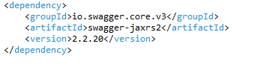
Add Openapi and Swagger dependencies
Apache CXF OpenAPI generator
Enables automatic generation of openapi.json from JAX-RS endpoints.
1
2
Swagger UI (WebJars)
Provides a ready-to-use web client to interact with the API directly in the browser.
3
Swagger Core + Annotations
Offers the necessary annotations to describe REST endpoints using the OpenAPI 3.0 standard.

Slide 7
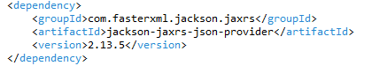
Add jackson-jaxrs-json provider dependency
Jackson JSON Provider
Automatically converts Java POJOs into JSON and vice versa.
4
We include the Jackson JAX-RS JSON provider in our project in order to handle automatic conversion between Java objects (POJOs) and JSON payloads.
This library enables automatic serialization and deserialization of Java objects to/from JSON, based on application/json content type.It integrates seamlessly with Apache CXF and JAX-RS, acting as the MessageBodyReader/Writer for JSON.

Slide 8
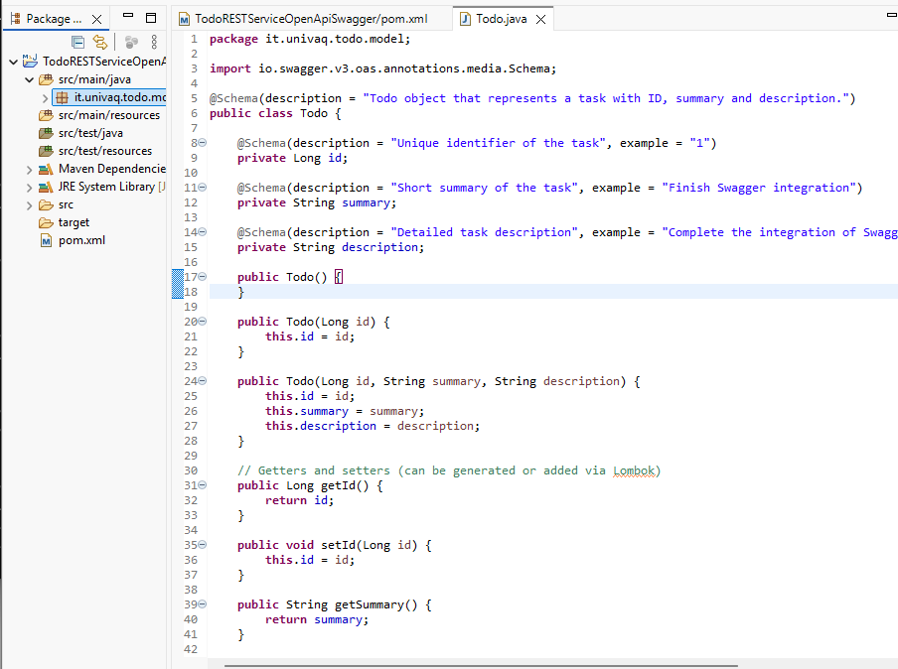
Create the Todo Class (it.univaq.todo.model)
The Todo class represents the data model used in our RESTful web service.It includes an id, a short summary, and a longer description field.Using @Schema annotations (from the OpenAPI specification), each field is documented for automatic Swagger UI generation.
These annotations allow:
clear documentation of fields
example values in Swagger UI
automatic schema generation in openapi.json

Slide 9
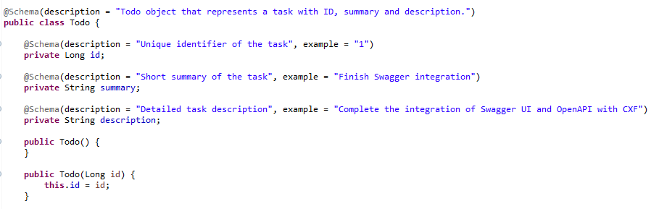
Annotation @Schema

Slide 10
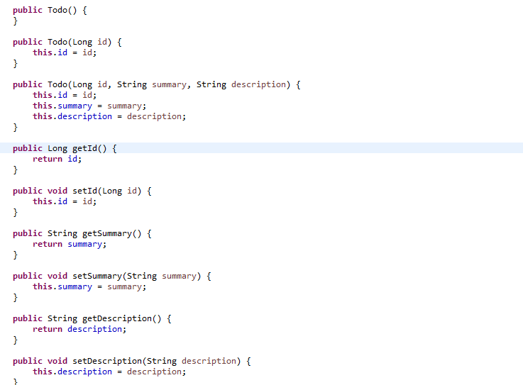
Create the Todo Class

Slide 11
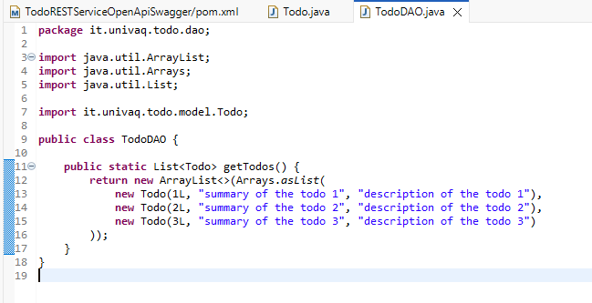
Create the TodoDAO class
The TodoDAO class provides a static list of Todo objects to simulate a database.It follows the DAO pattern to separate the data source from the rest of the application.The getTodos() method will be called by the REST controller to return the list of tasks in JSON format.

Slide 12
Just not to forget... ☺
POST is used to create a resource. It has associated data that defines the resource
GET is used to read the value of a resource and return that to the requestor in the specified representation, such as XHTML, that can be rendered in a web browser
PUT is used to update the value of a resource
DELETE is used to delete the resource

Slide 13
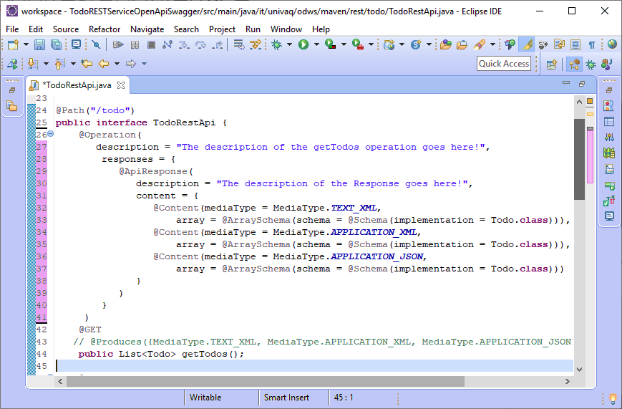

Create the TodoRestApi Interface
text/xml vs application/xml
This is an old question, but from the RFC 7303 recommendations (section 9.2):
“The registration information for text/xml is in all respects the same as that given for application/xml above (Section 9.1), except that the “Type name” is “text”.”
2

Slide 14
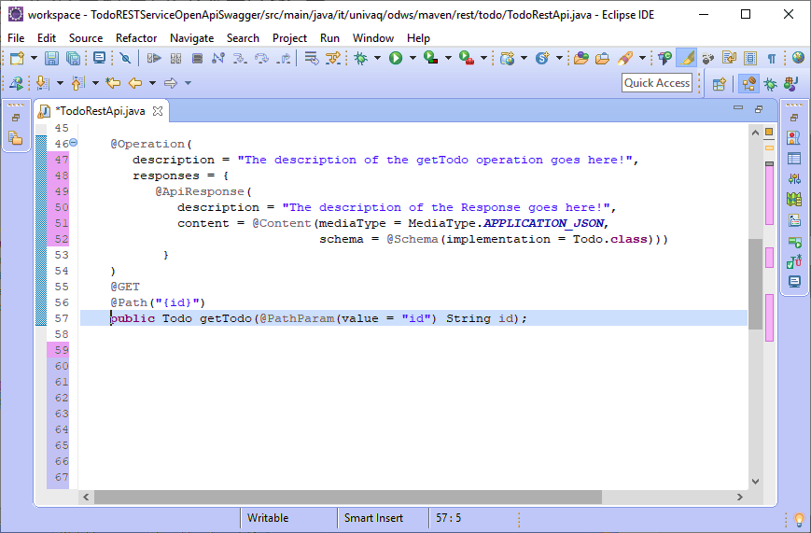
Create the TodoRestApi Interface
1

Slide 15
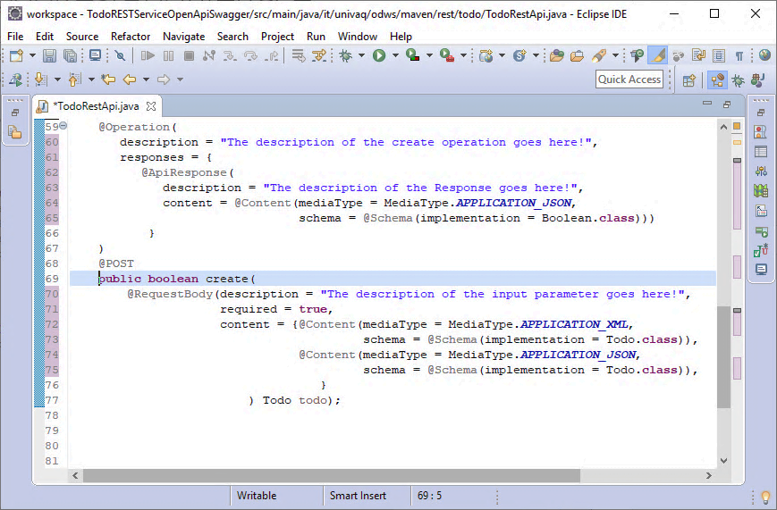
Create the TodoRestApi Interface
1

Slide 16
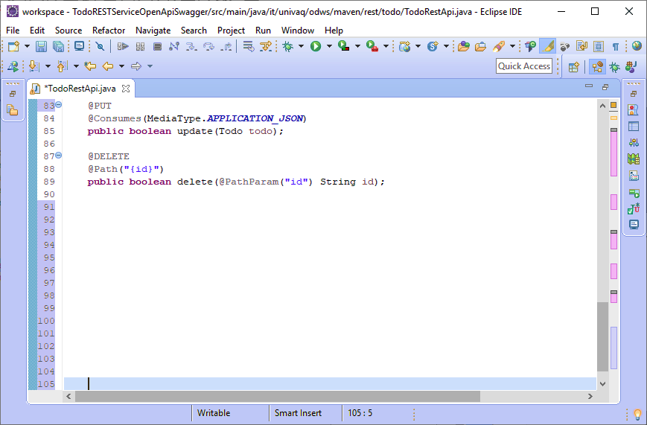
Create the TodoRestApi Interface
See mediaType=application/json for the PUT method within the representaiton tag of the WADL in next slides
1
2

Slide 17
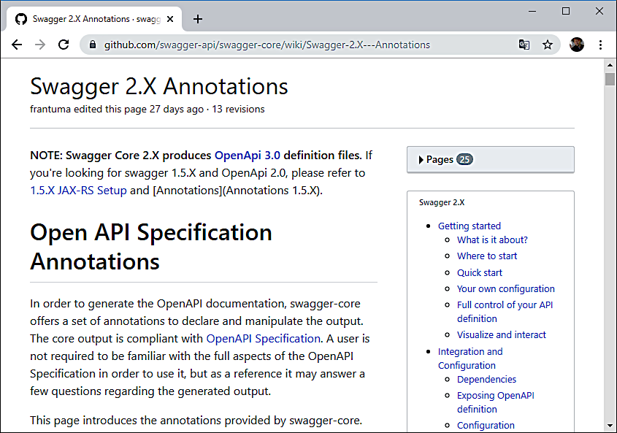
Complete Description of Swagger Annotations
1

Slide 18
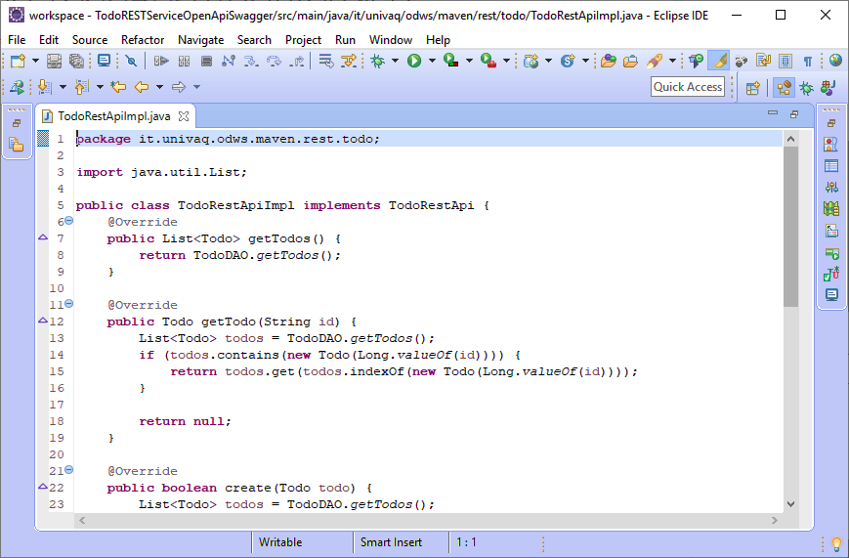
Implement the TodoRestApi Interface
1
2
3

Slide 19
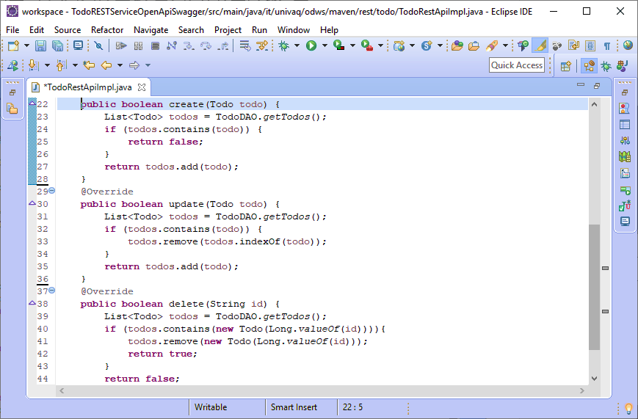
Implement the TodoRestApi Interface
1
2
3

Slide 20
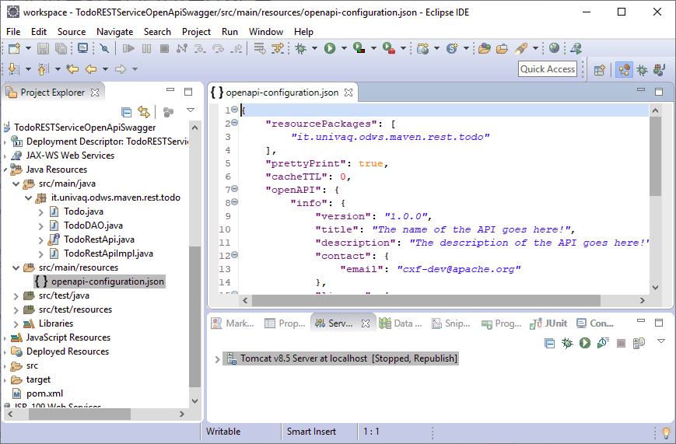
Create the openapi-configuration.json
1
This configuration can also be done programmatically in Java or using Spring
https://cwiki.apache.org/confluence/display/CXF20DOC/OpenApiFeature#OpenApiFeature-ConfiguringinCXFNonSpringJaxrsServlet

Slide 21
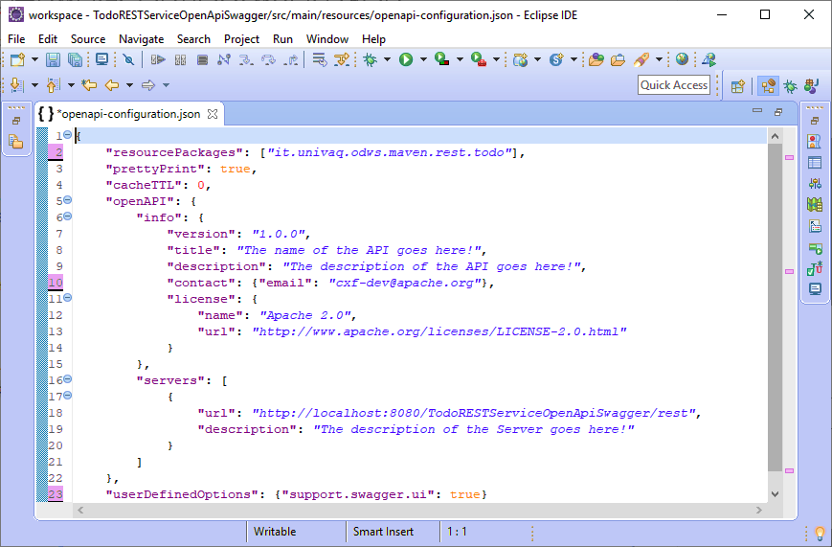
Create the openapi-configuration.json
1
2

Slide 22
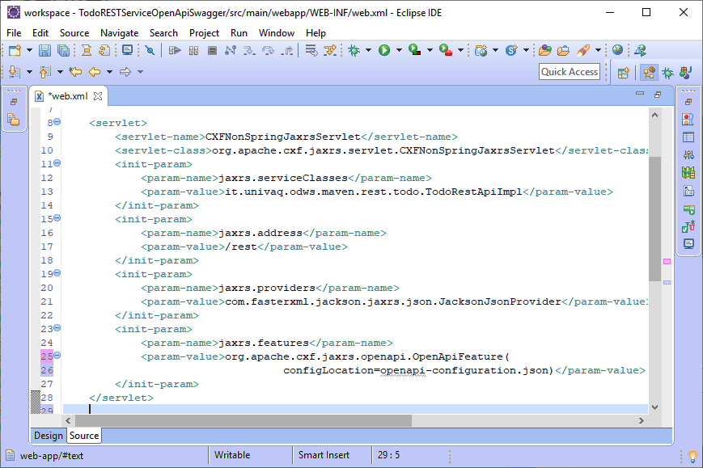
Configure the servlet
1
2

Slide 23
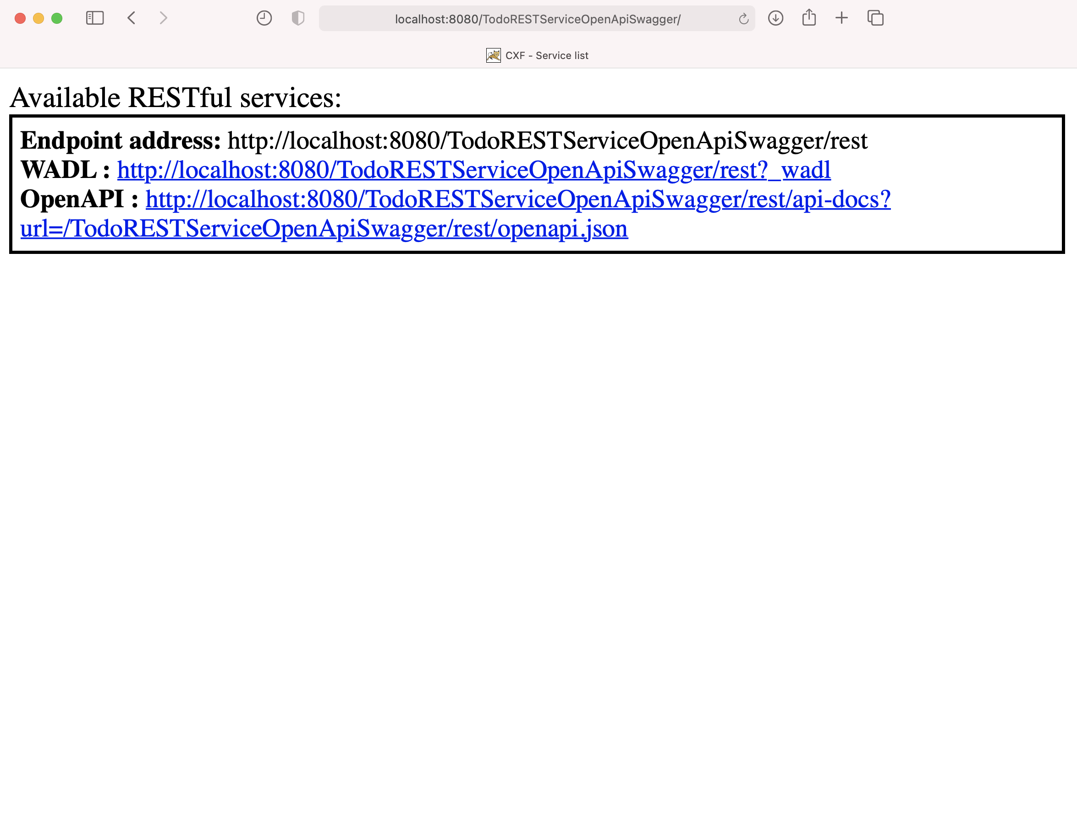
Deploy the REST Service
1

Slide 24
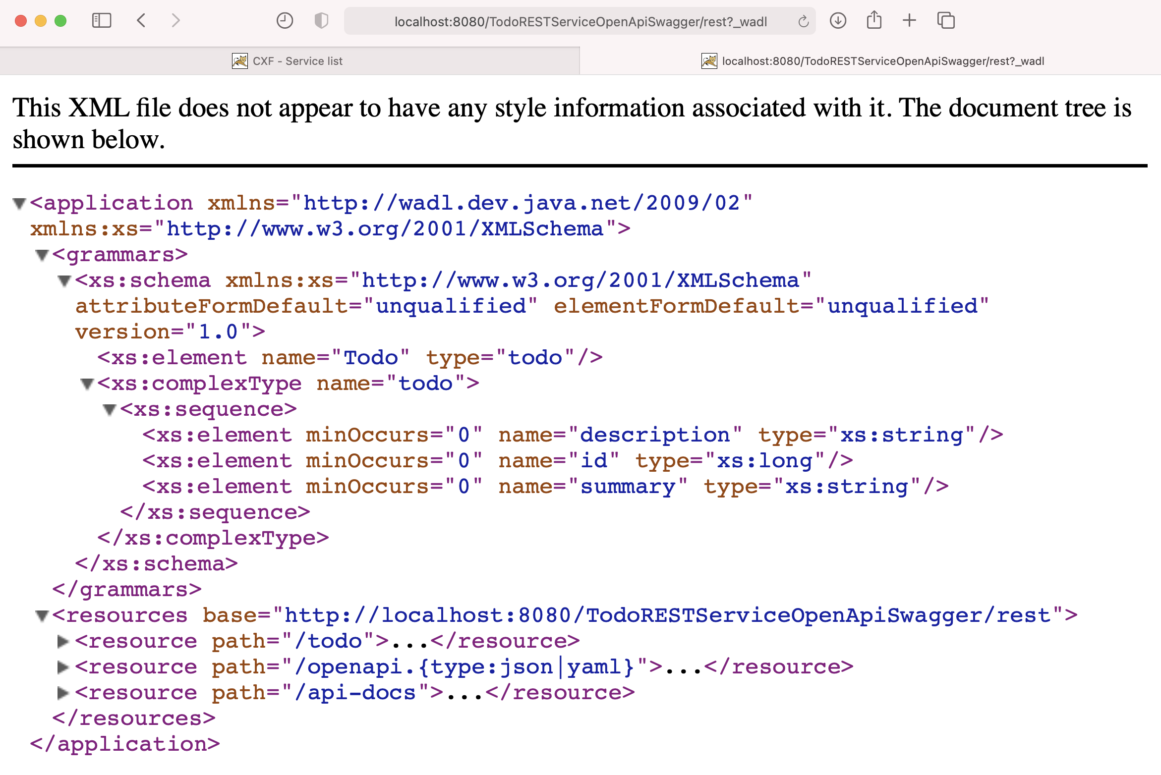
The REST API description - WADL
1
3
2

Slide 25
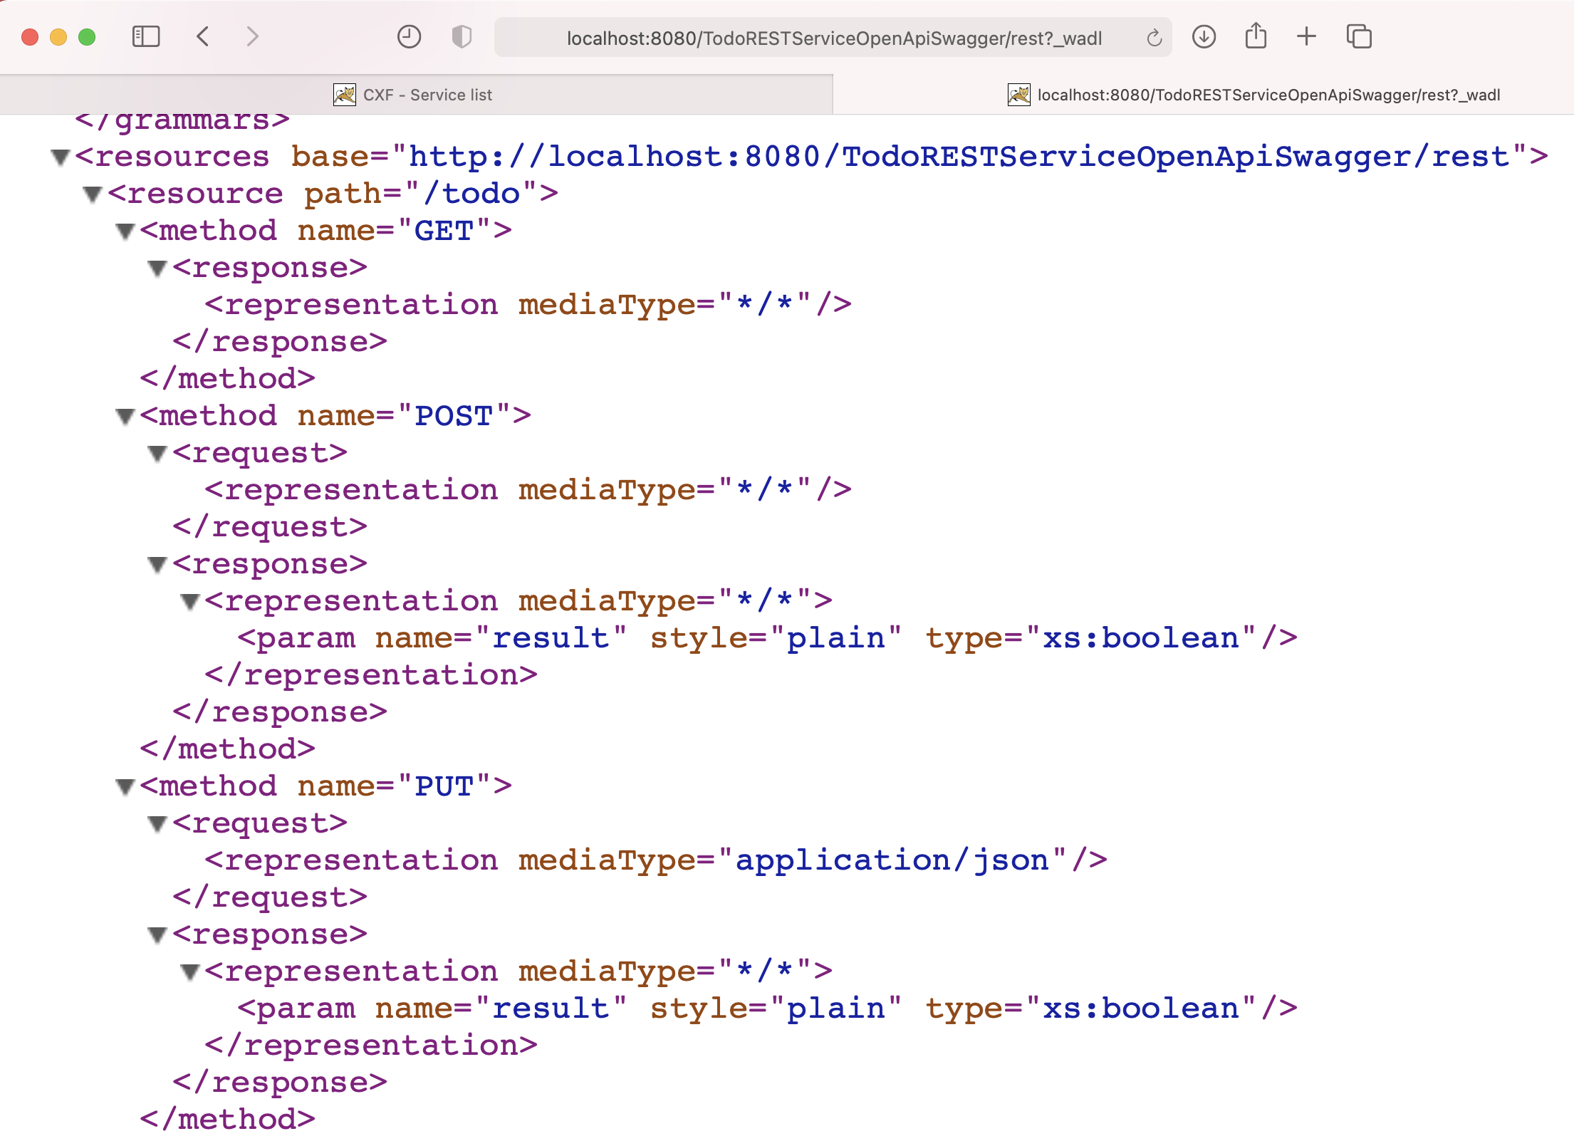
The REST API description - WADL
1.1
1.2
1.3

Slide 26
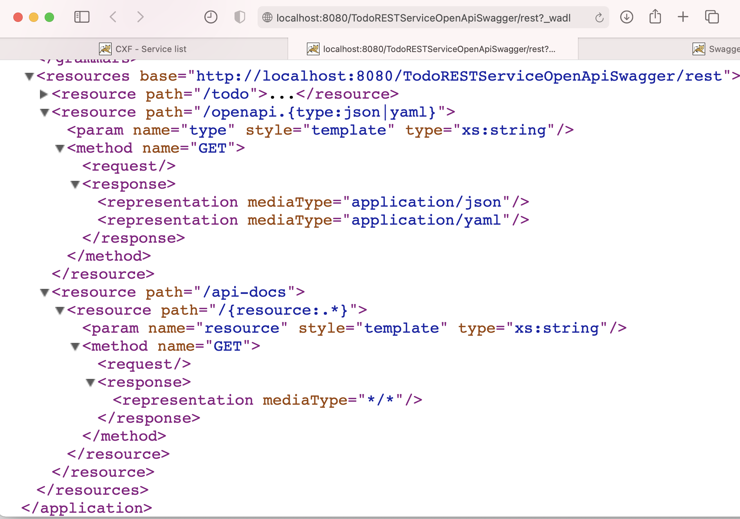
The REST Api description - WADL
2
2.1
3
3.1

Slide 27
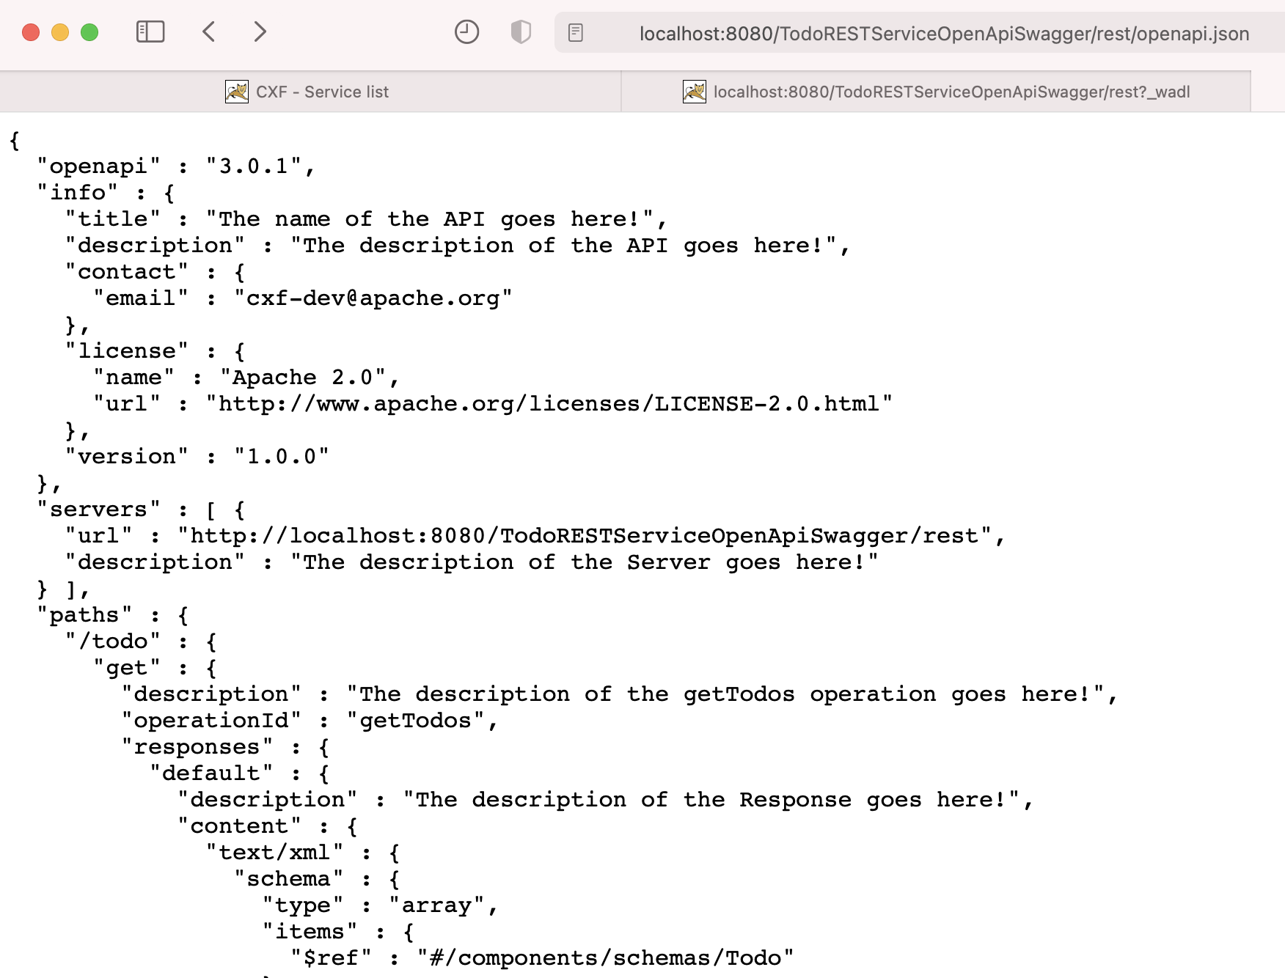
The REST API description - JSON
1

Slide 28
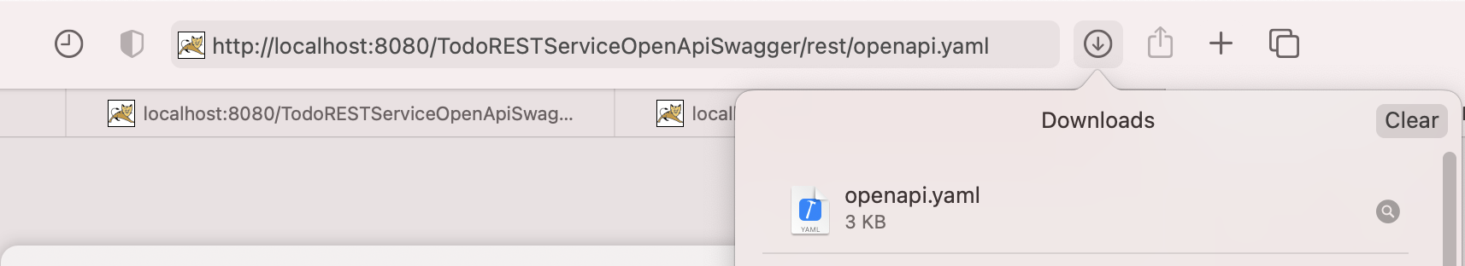
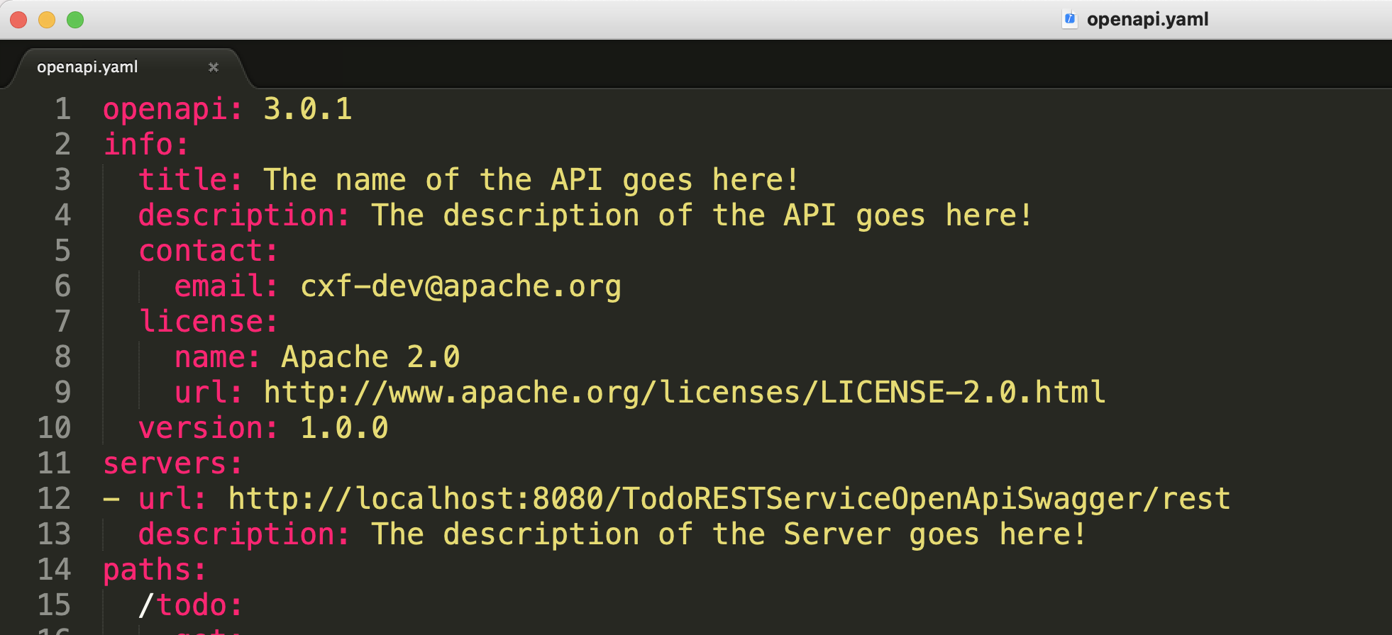
The REST Api description - YAML
1
2
2

Slide 29
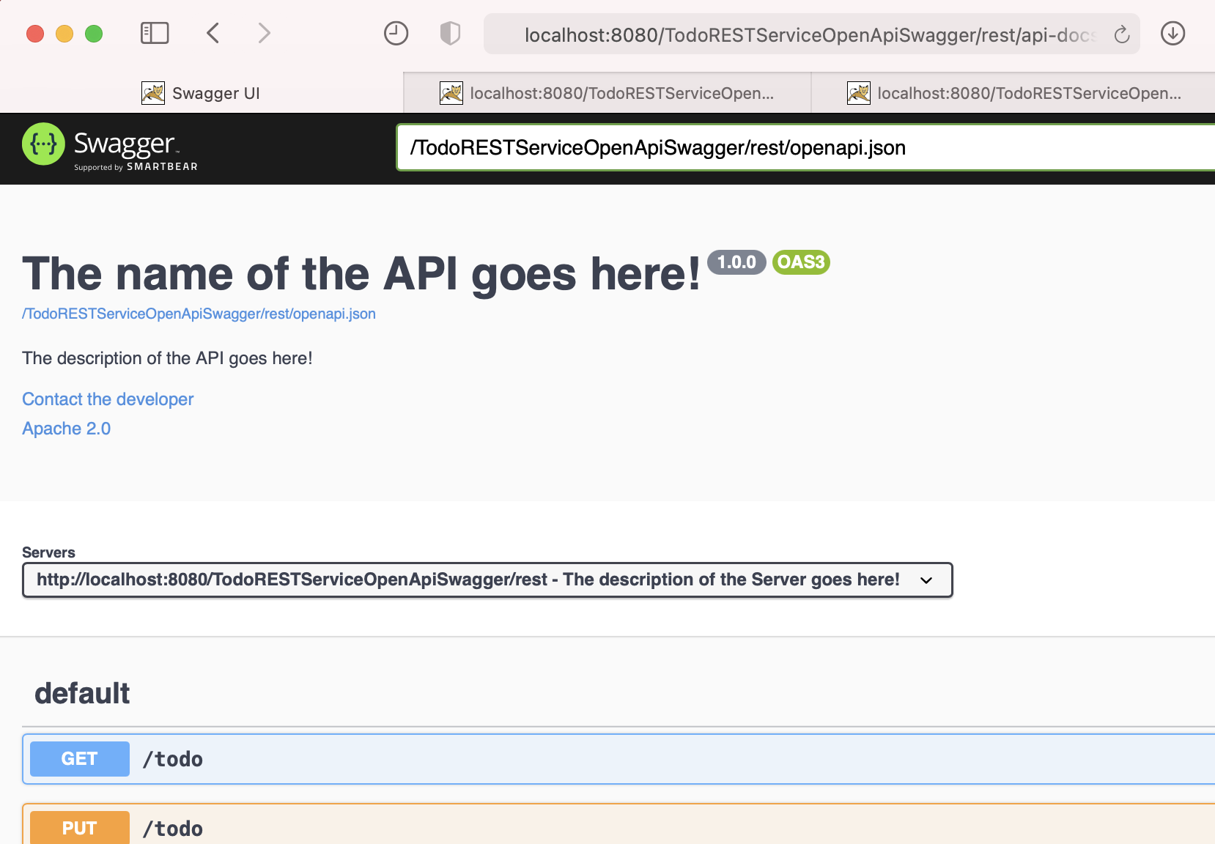
Swagger api-docs
1
2
point to .yaml or .json url
3

Slide 30
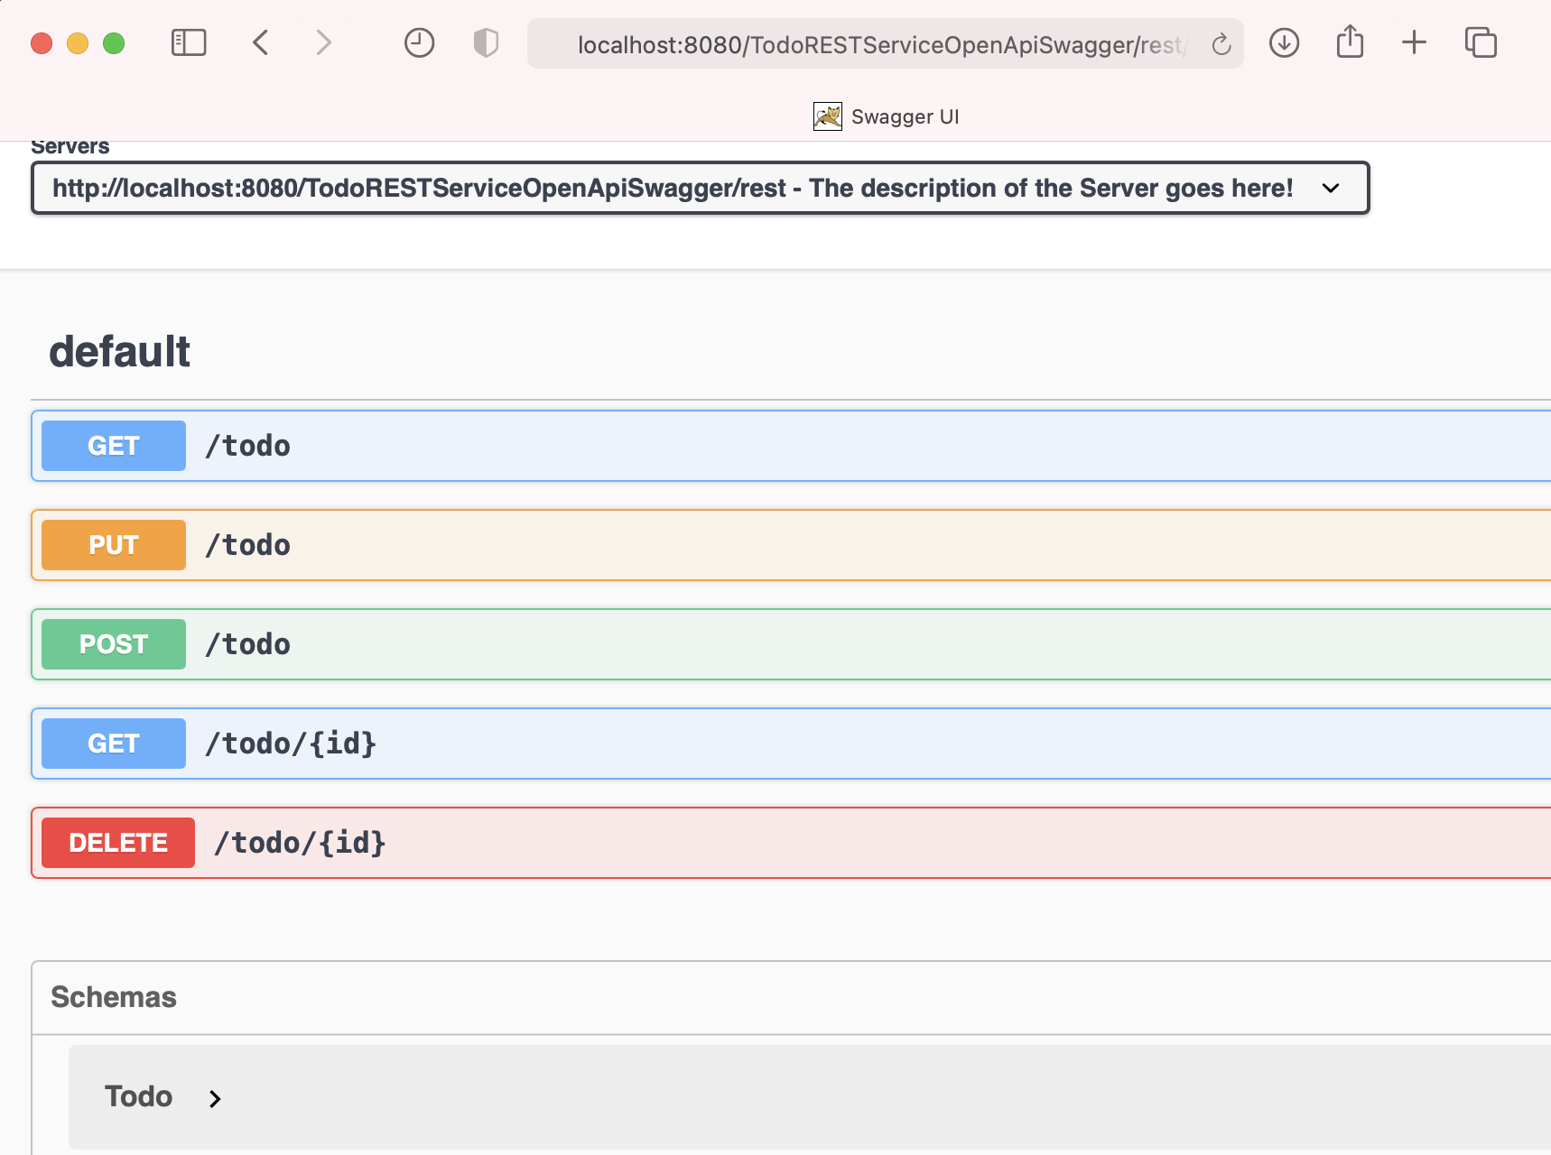
Swagger api-docs
List<Todo> getTodos()
boolean update(Todo todo)
boolean create(Todo todo)
Todo getTodo(String id)
boolean delete(String id)

Slide 31
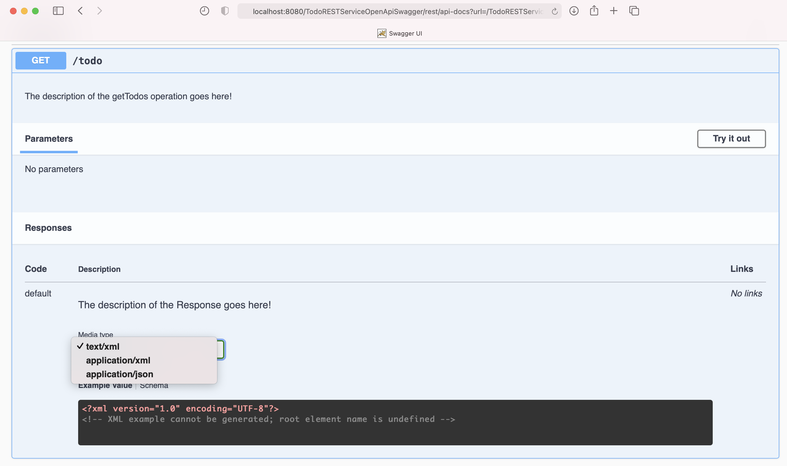
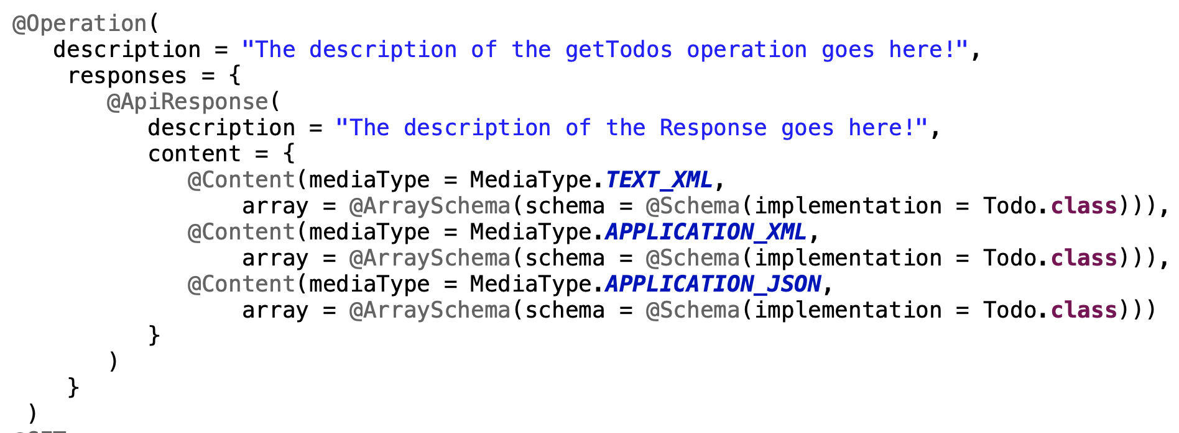
Try to invoke GET /todo
List<Todo> getTodos()
1
2
3

Slide 32
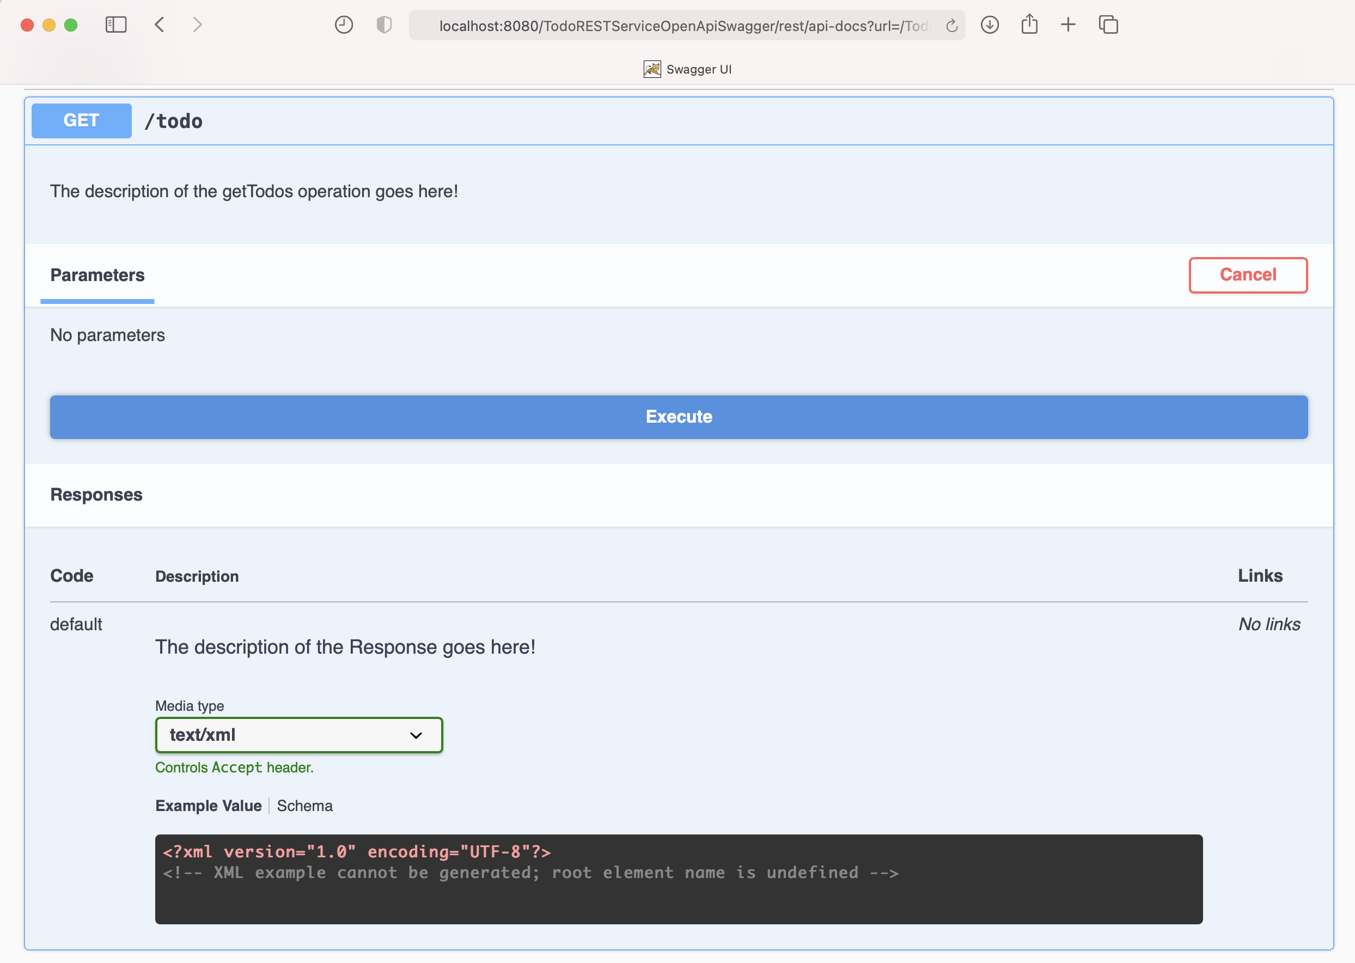

Try to invoke GET /todo
1
2

Slide 33
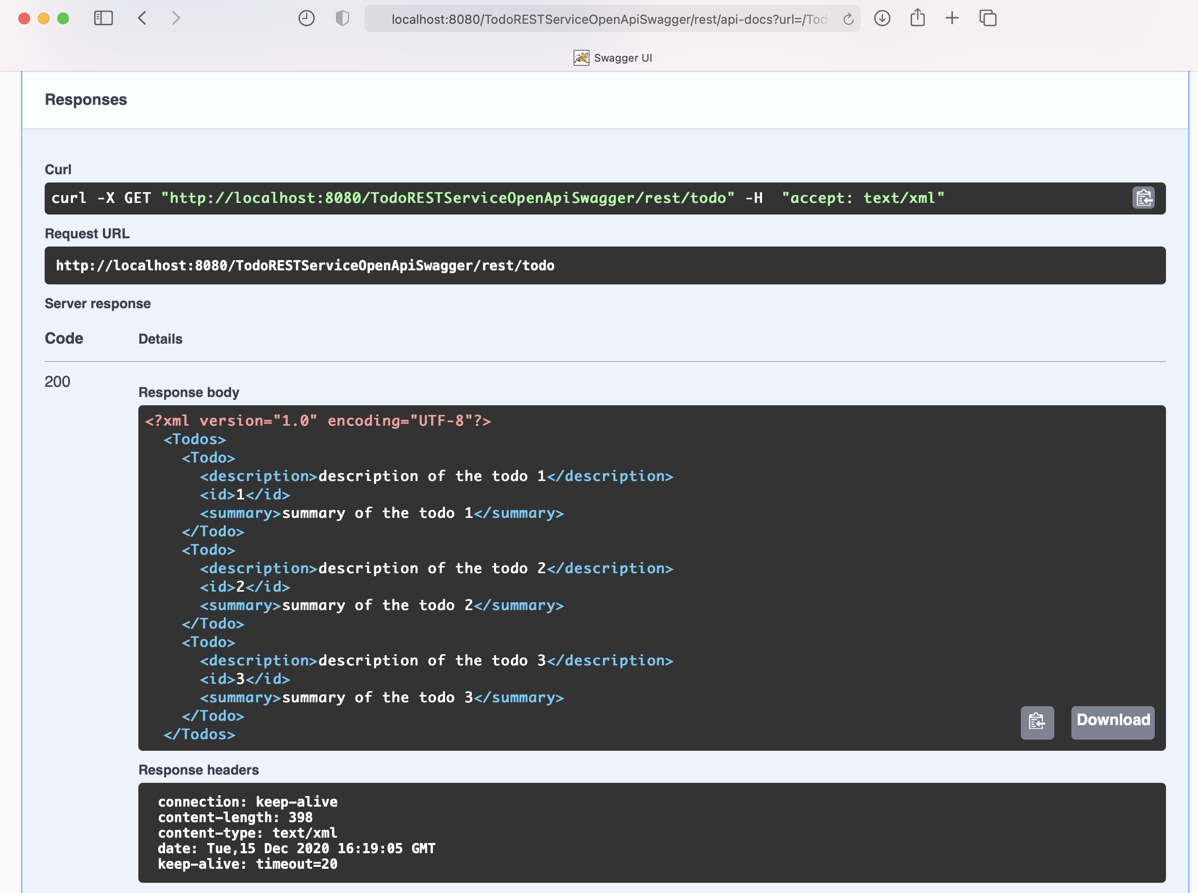
Try to invoke GET /todo
1
2
XML response body

Slide 34
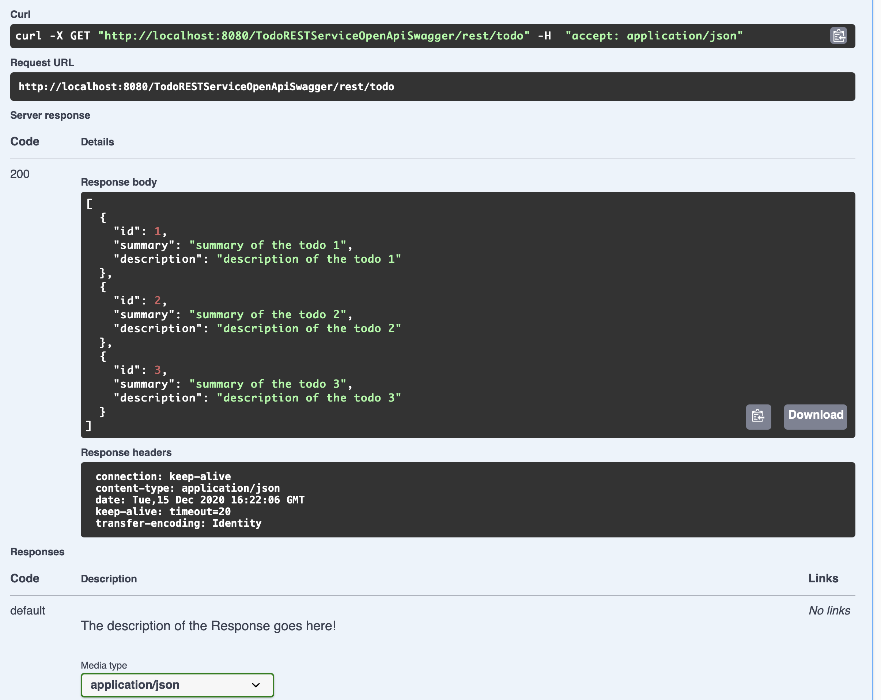
Try to invoke GET /todo
1
2
JSON response body
1

Slide 35
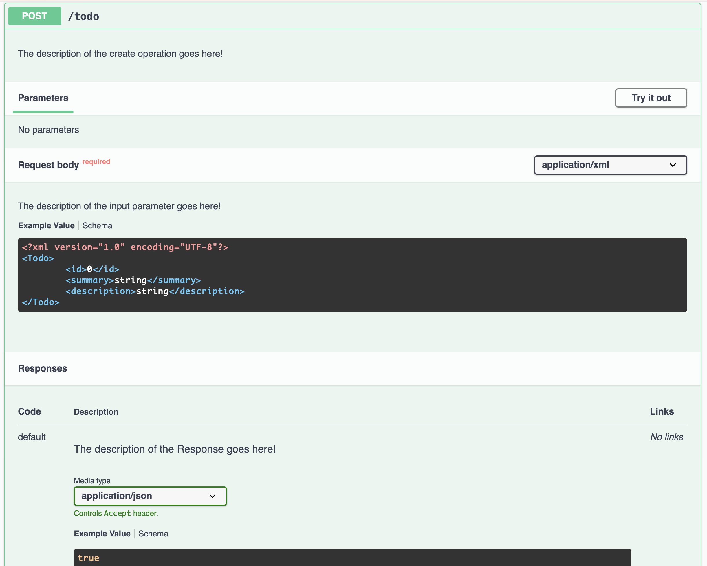
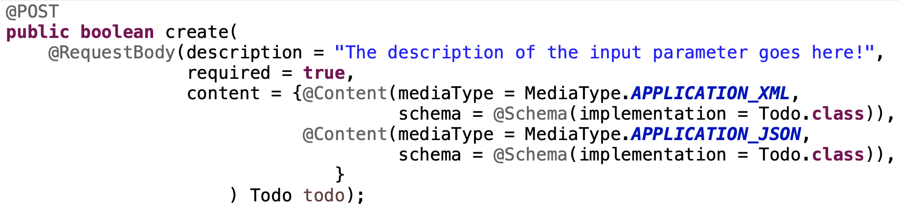
Try to invoke POST /todo
boolean create(Todo todo)
2
1
3

Slide 36
Try to invoke POST /todo
XML request body
1
2
3

Slide 37
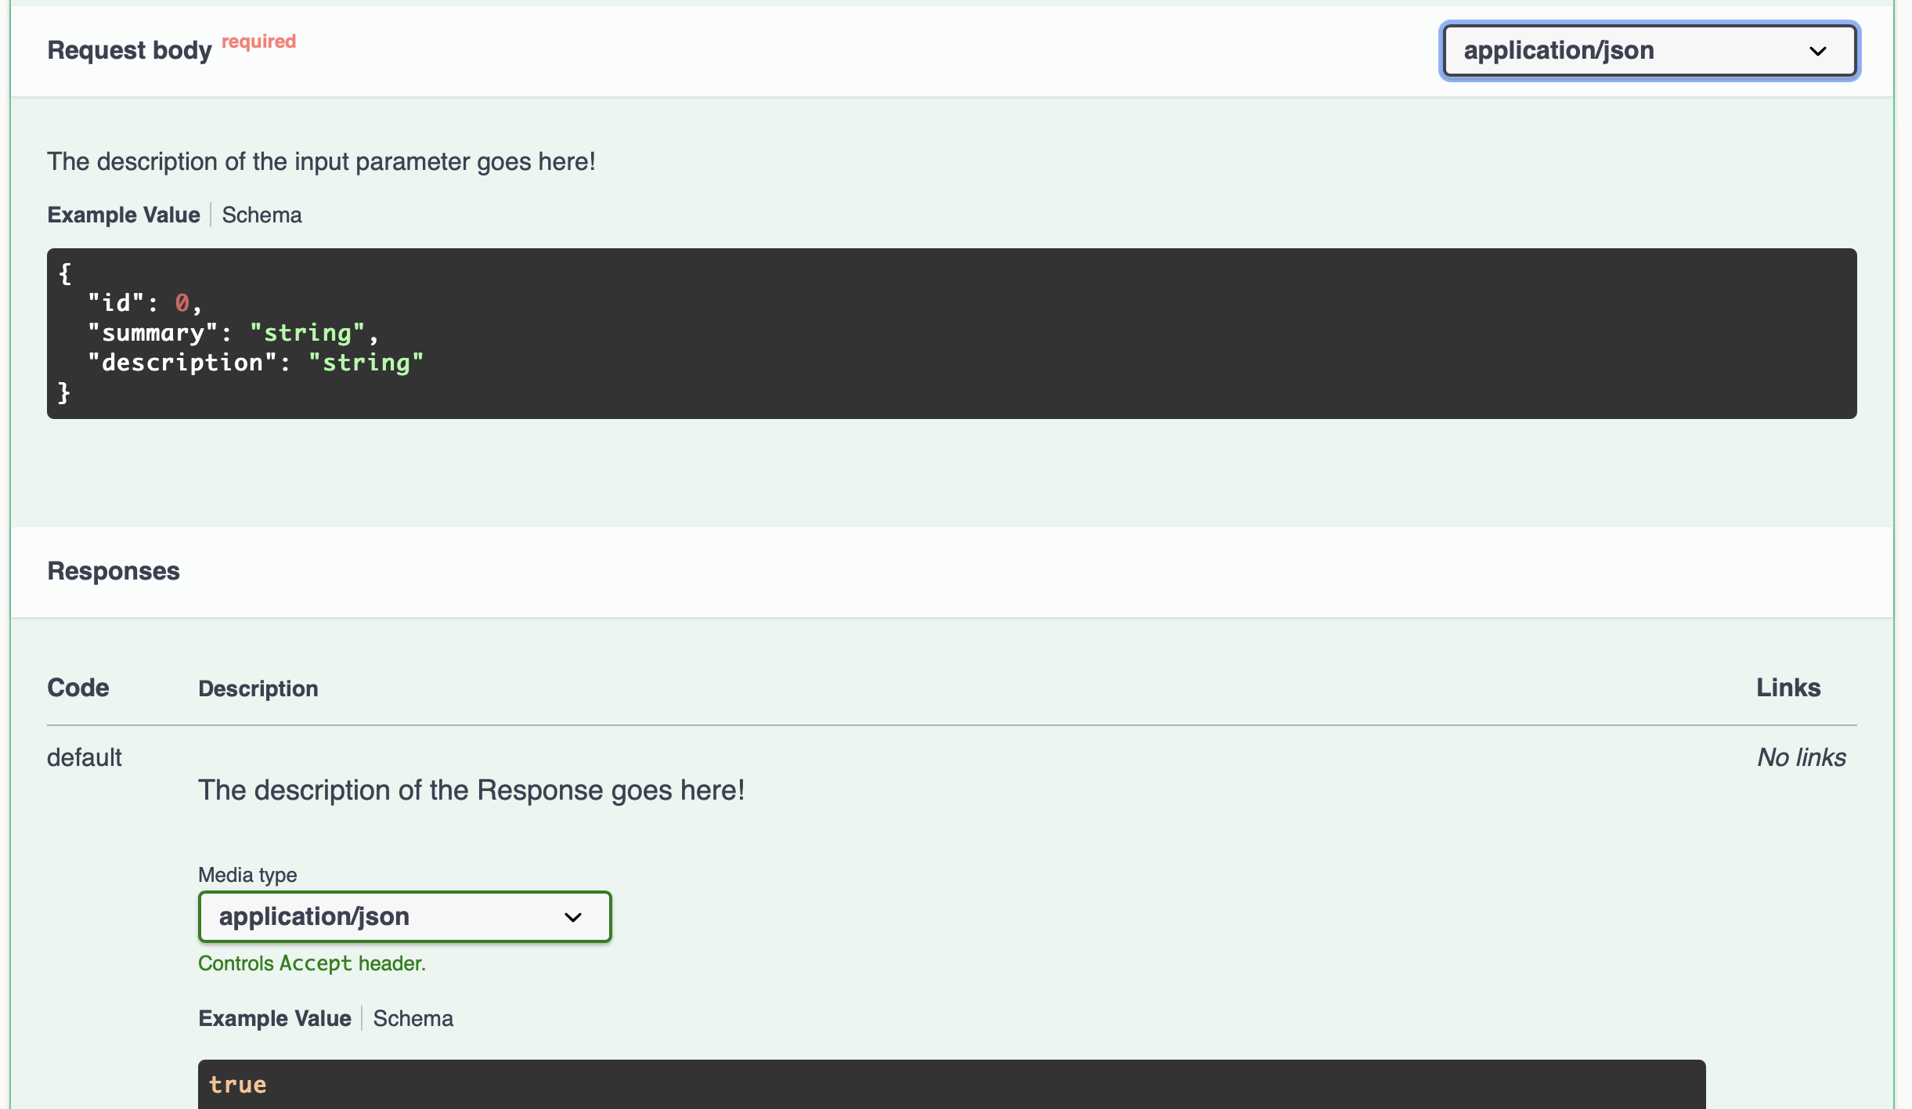
Try to invoke POST /todo
1
2
JSON request body

Slide 38
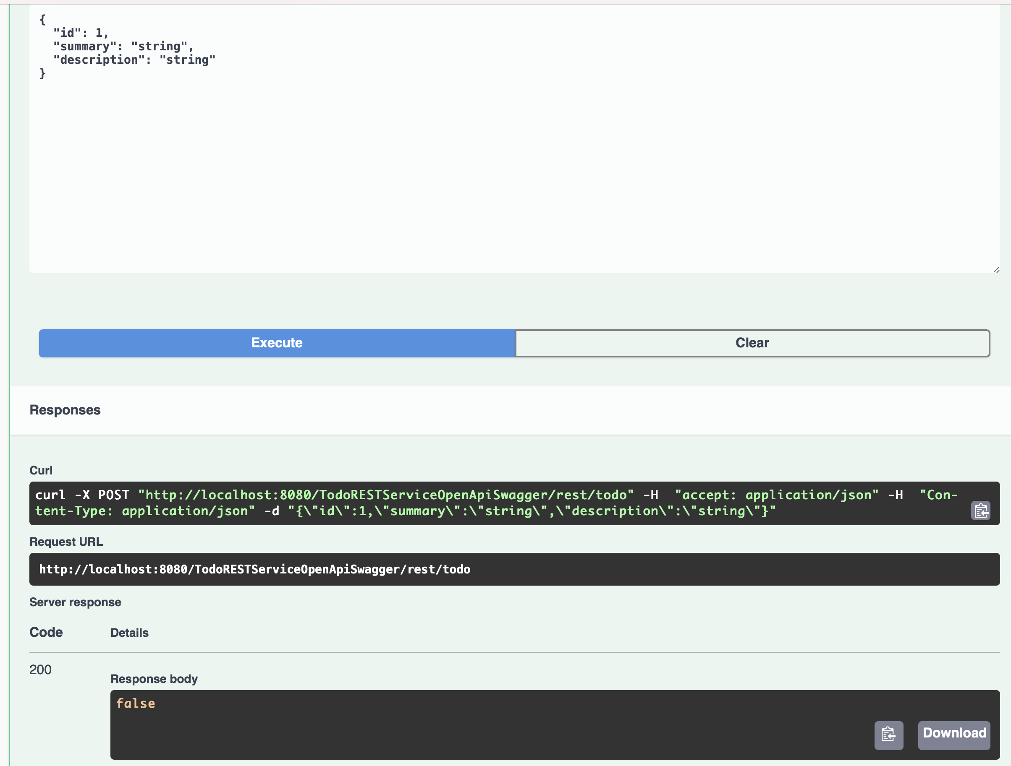
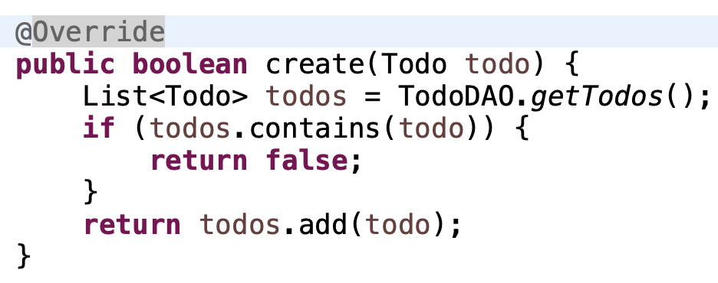
Try to invoke POST /todo
1

Slide 39

Try to invoke POST /todo
1

Slide 40
Generate a “jaxrs-cxf-client”
for our REST service

Slide 41
Save the JSON or YAML Description
1

Slide 42
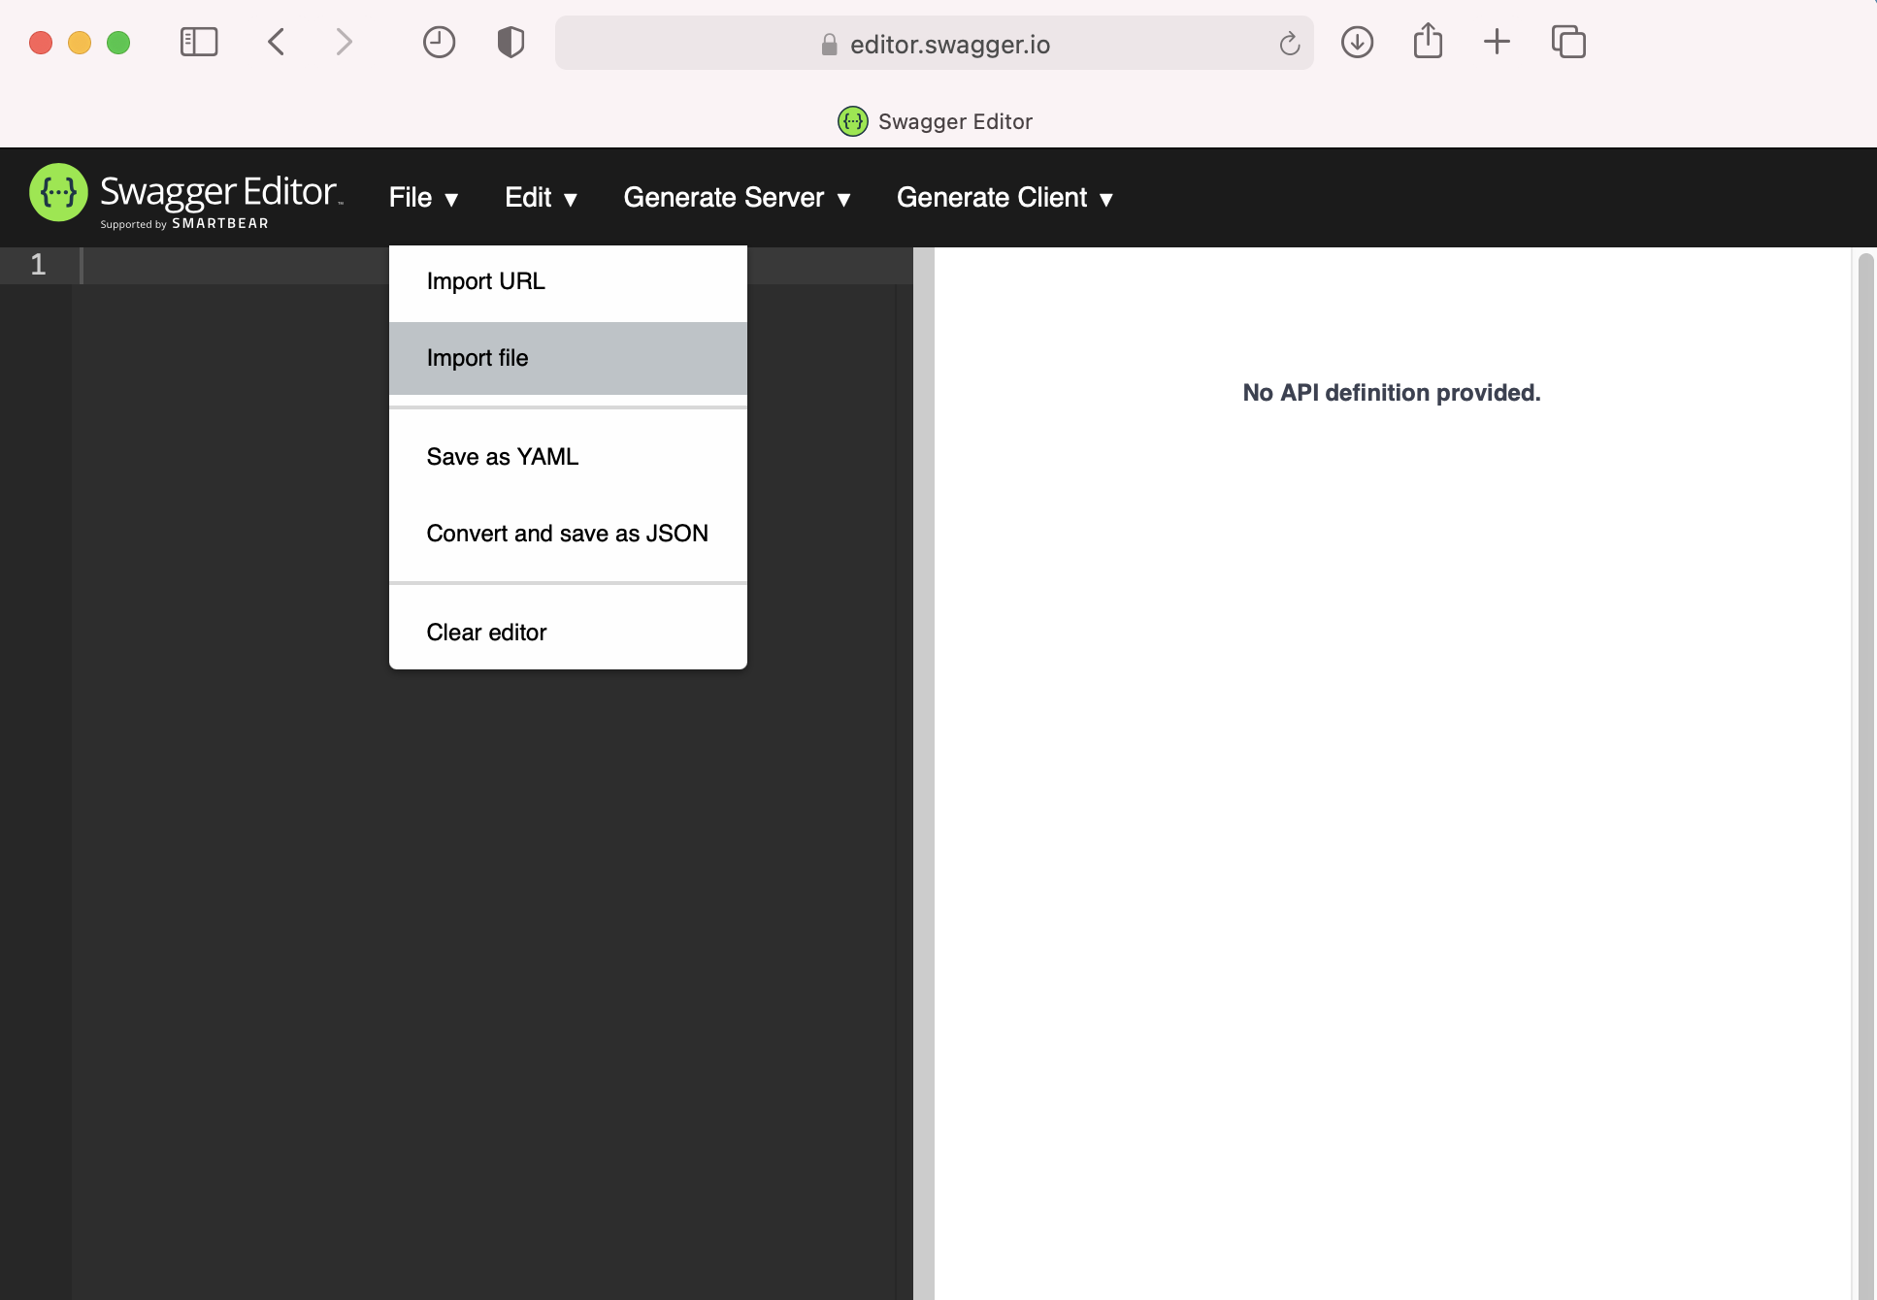
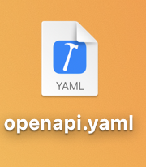
Import the JSON or YAML Description
1
2
1
I opted for importing the openapi.yaml file

Slide 43
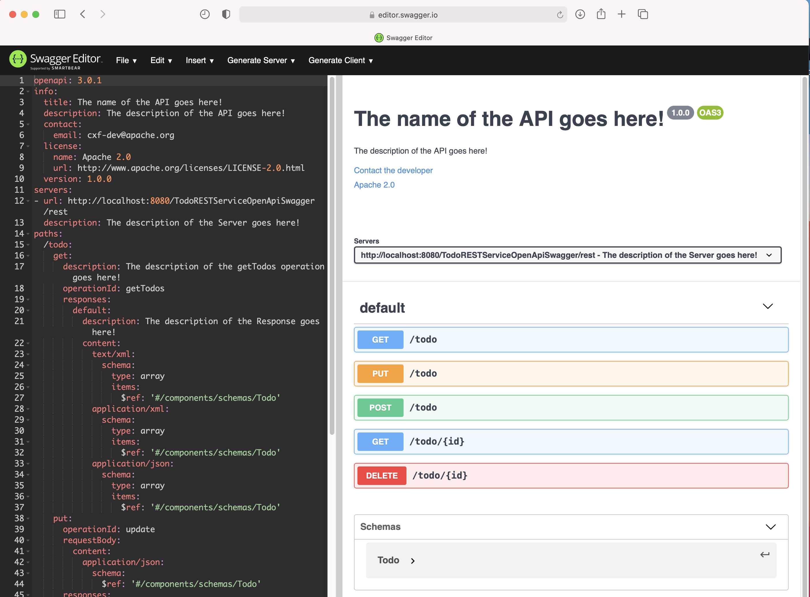
Import the JSON or YAML Description
1

Slide 44
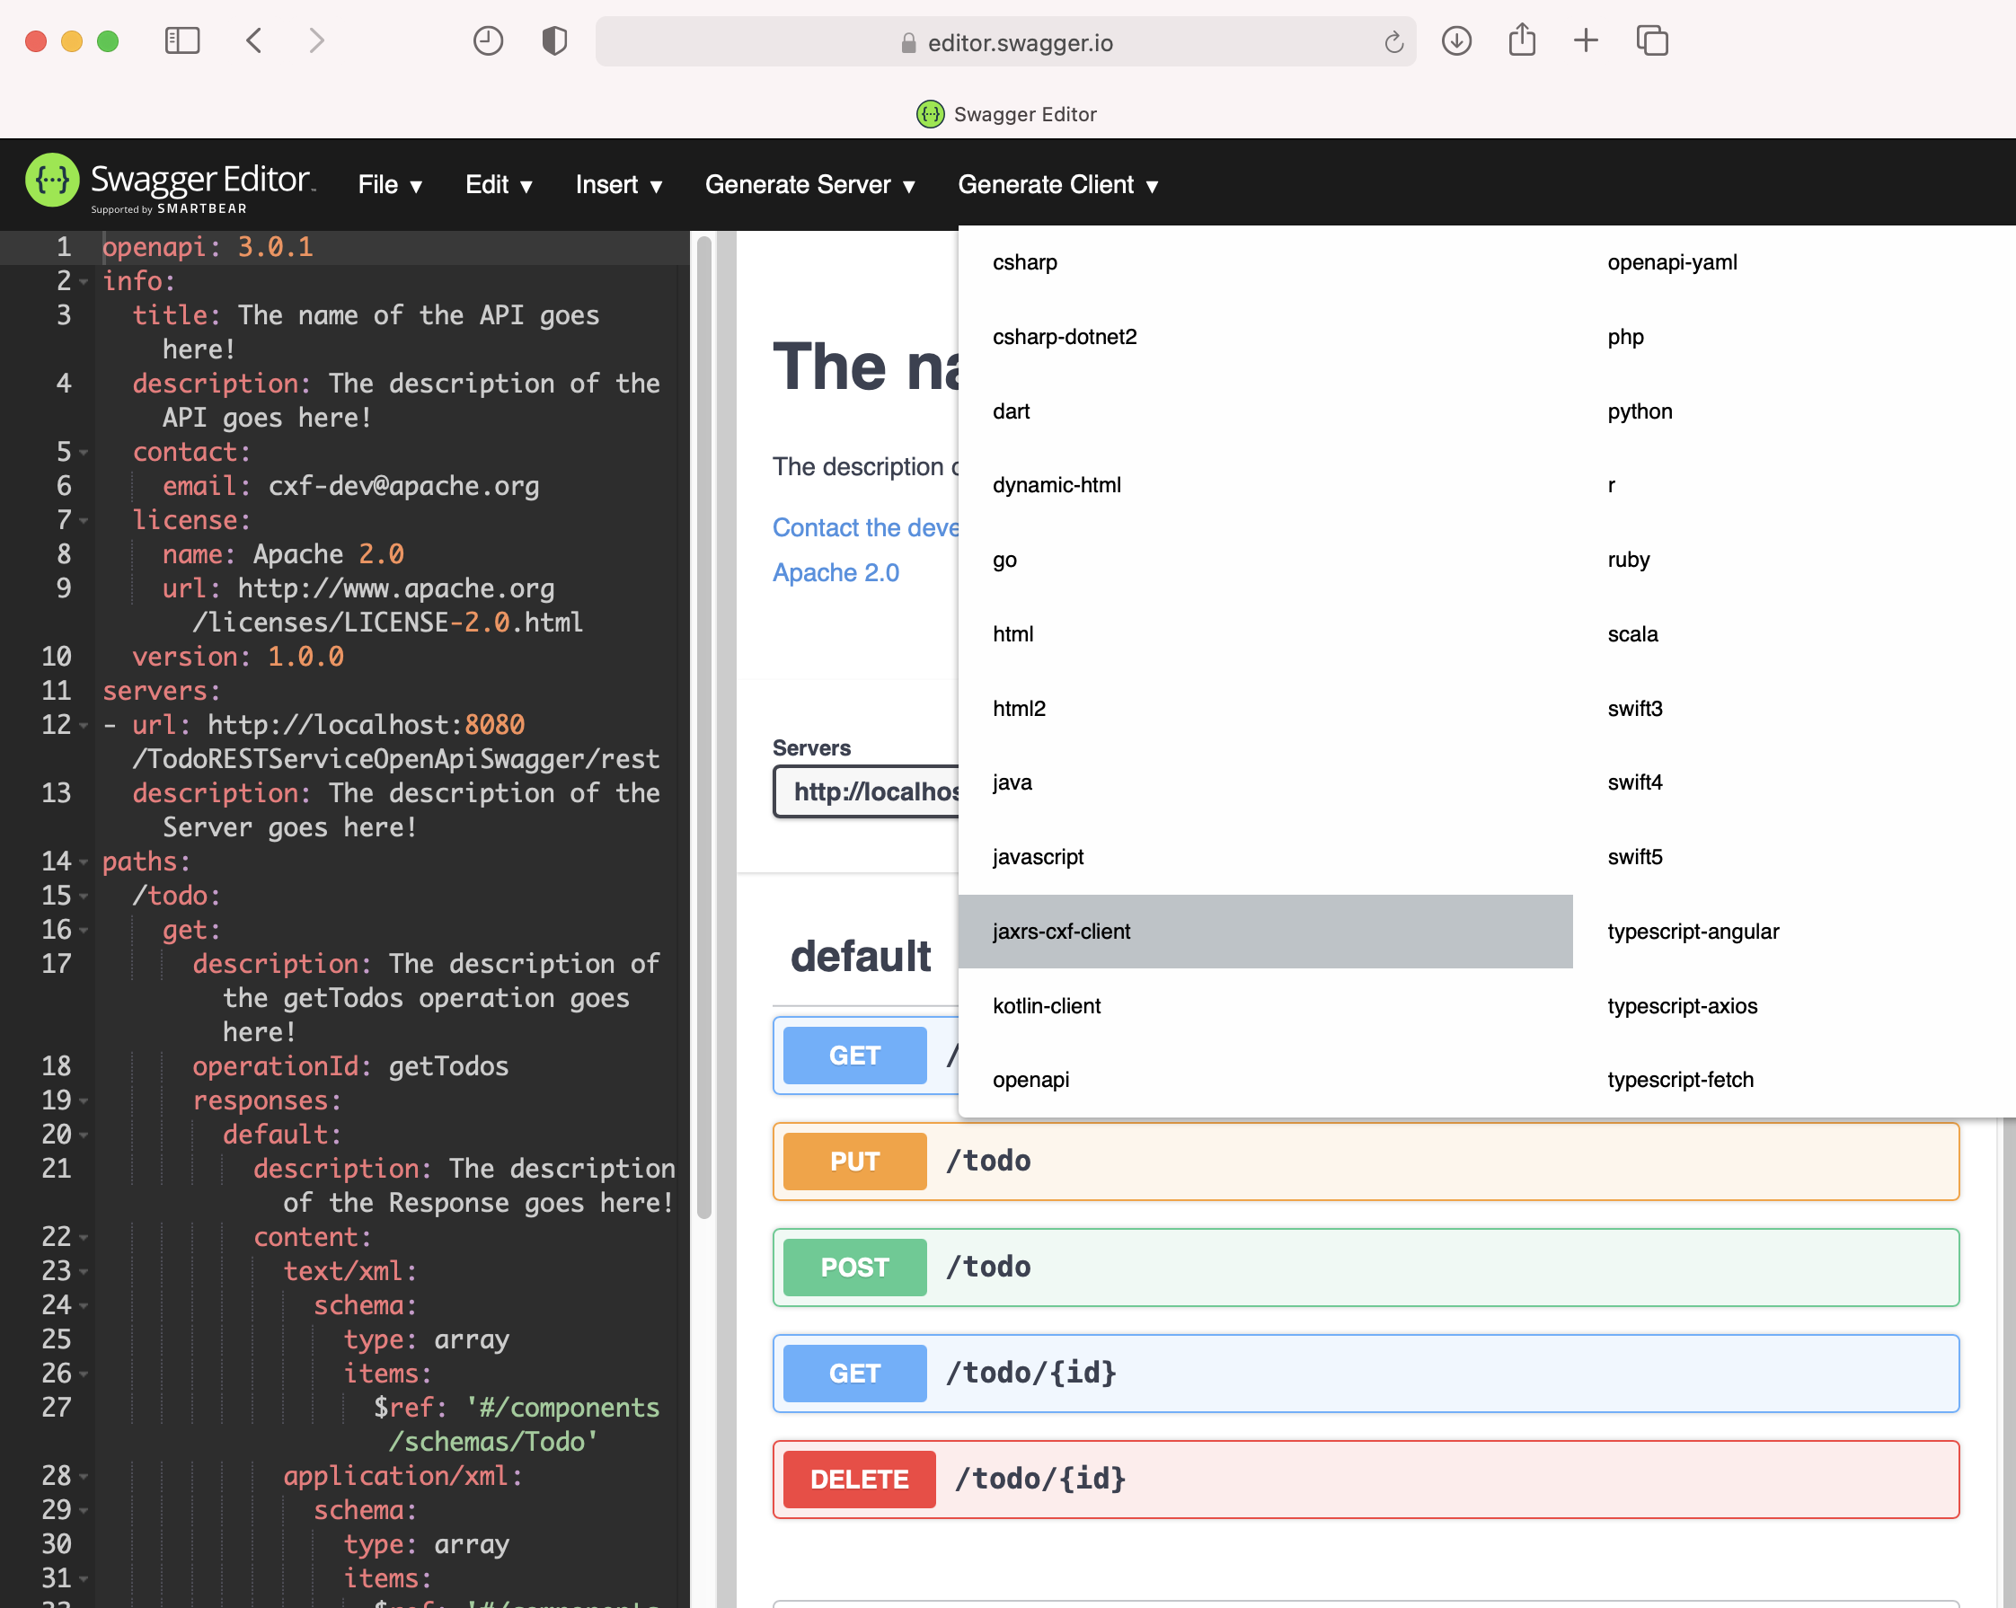
Generate the jaxrs-cxf-client Project
1
2

Slide 45
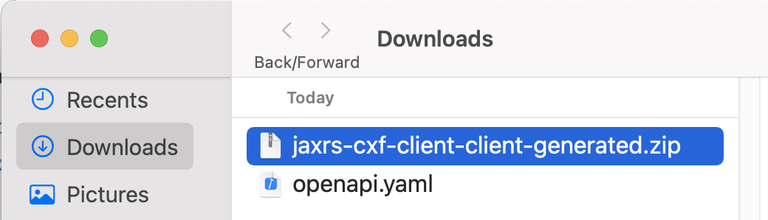
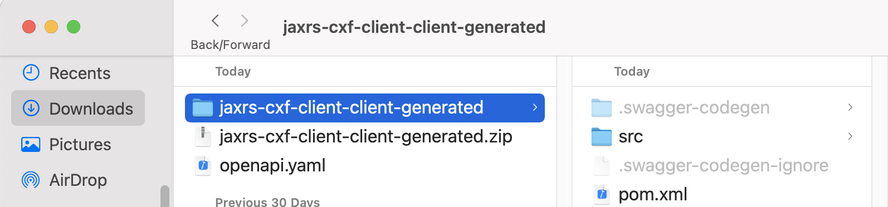
Generate the jaxrs-cxf-client Project
1
2
You get a mavenized project... That’s simply great ☺

Slide 46
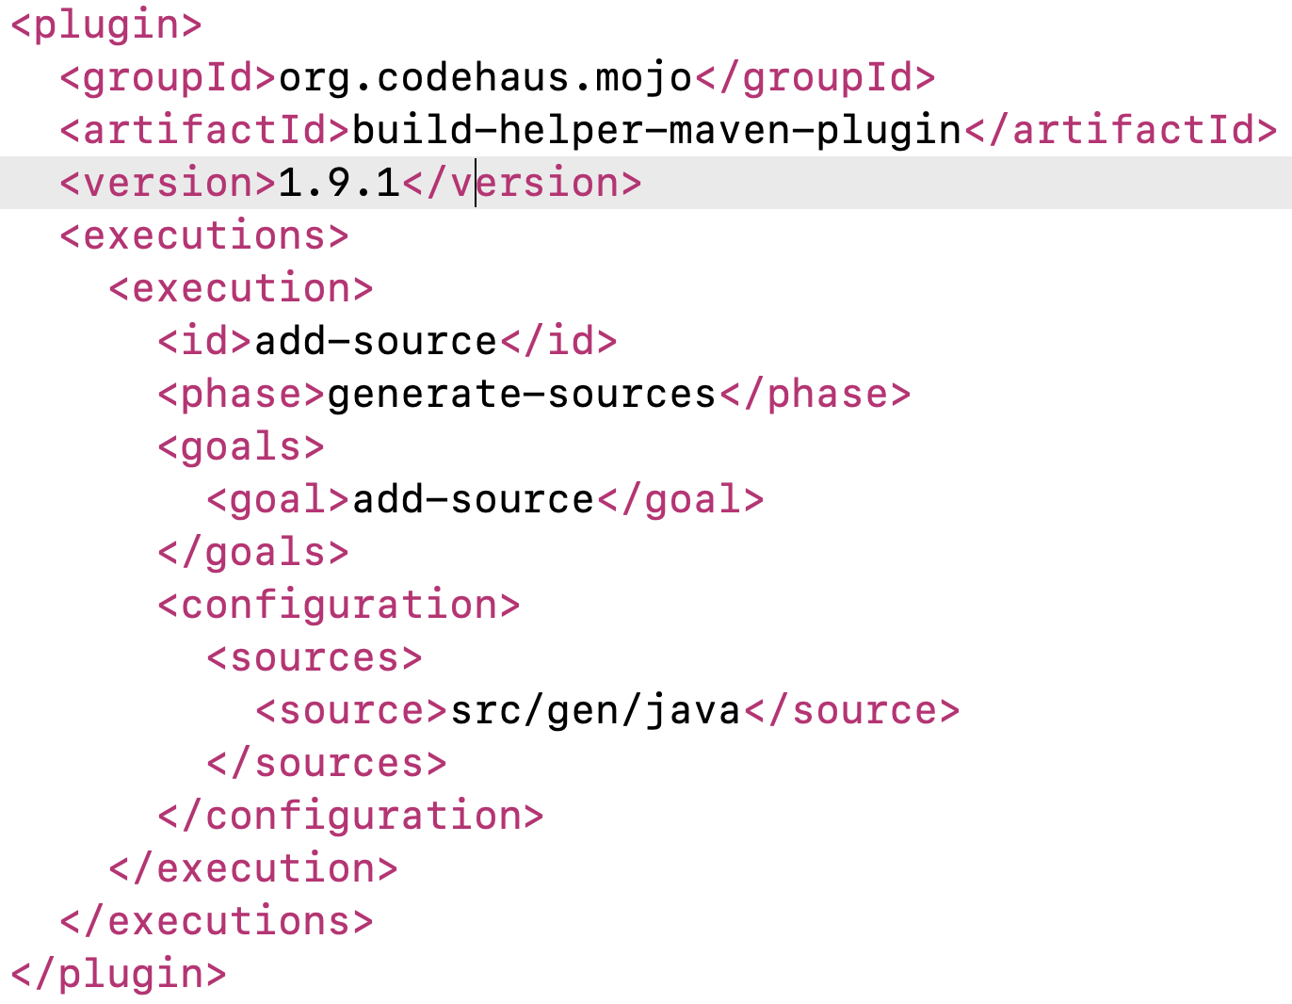
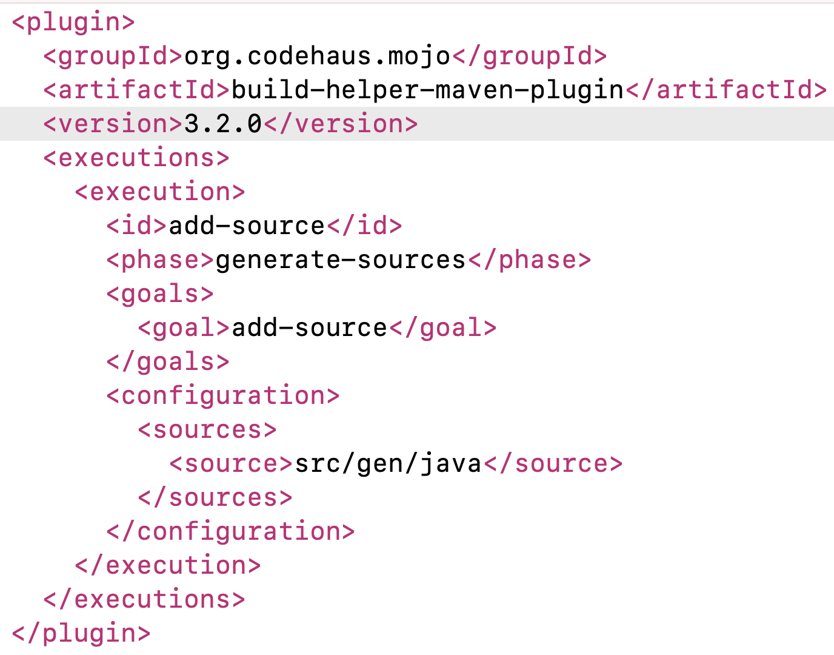
Fix the pom.xml
Fix the version

Slide 47
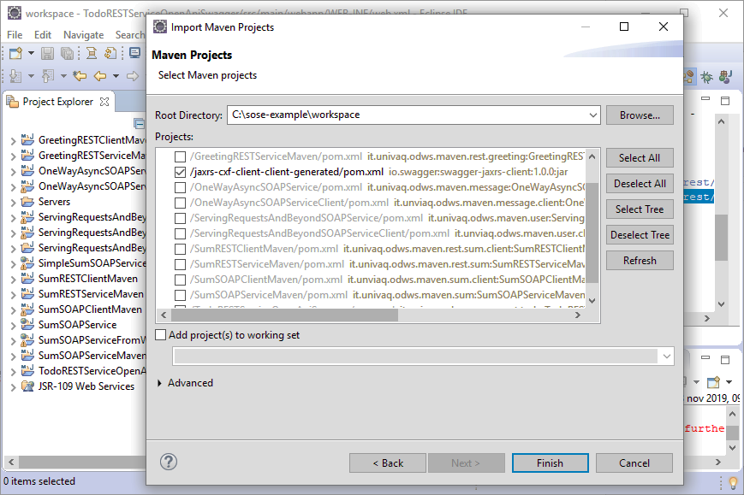
Import the jaxrs-cxf-client Project
1

Slide 48

Check the Generated Classes
1
2

Slide 49

Check the Generated Classes
Since it is a “create” operation, the code 201 would be more appropriate
1
2
https://restfulapi.net/http-status-codes/

Slide 50

Fix the Todo Class
1
@javax.xml.bind.annotation.XmlRootElement
Maps a class or an enum type to an XML element

Slide 51

Check the DefaultApiTest Class
1

Slide 52

Implement the createTest
1
2
3
4
5

Slide 53

Implement the deleteTest
1
2
3
4
5

Slide 54

Implement the getTodoTest
1
2
3
4

Slide 55

Implement the getTodosTest
1
2
3

Slide 56

Implement the updateTest
1
2
3

Slide 57

Execute Tests
Do not forget to run the “TodoRESTServiceOpenApiSwagger” service first ☺
2
3
1

Slide 58

Check Tests Execution
1
2

Slide 59

Generating the REST Client
That’s the method we have used so far for generating the REST Client
https://fizzylogic.nl/2018/09/26/learn-how-to-quickly-generate-rest-clients-from-swagger-files/

Slide 60

Alternative Way for Generating the REST Client (1/3)

Slide 61

Alternative Way for Generating the REST Client (2/3)
Three arguments → next slide

Slide 62

Alternative Way for Generating the REST Client (3/3)

Slide 63
References
http://cxf.apache.org/docs/openapifeature.html
https://swagger.io/docs/specification/about/
https://swagger.io/
https://voicebase.readthedocs.io/en/v3/how-to-guides/swagger-codegen.html#download-swagger-codegen-cli-tool
https://fizzylogic.nl/2018/09/26/learn-how-to-quickly-generate-rest-clients-from-swagger-files/

